Slide 1

Building an Irresistible Digital Presence
Authors: Ana Cruz and Stelios Karatzas

Slide 2
Learning Objectives
Develop an effective and consistent digital presence
Create content synergies
Differentiate media types: paid, owned, and earned
Understand stakeholder experience
Develop information architecture based on a persona
Use KPIs to assess a digital presence

Slide 3
Defining Digital Presence
Digital Presence: A cohesive representation of an organisation across digital platforms.
Components: Websites, apps, blogs, emails, social media profiles.
Importance: Builds trust, credibility, engagement, and loyalty.
Stakeholder Interaction: Co-created with stakeholders.

Slide 4
Building Presence
Strategic Importance: A focal point for personas, delivering value propositions.
1
Consistency: Imagery, messaging, and engagement must be consistent.
2
Identity: Reflects what the organisation stands for now and in the future.
3
Examples: Volvo (safety), Apple (simplicity), Fortnite (entertainment).
4

Slide 5
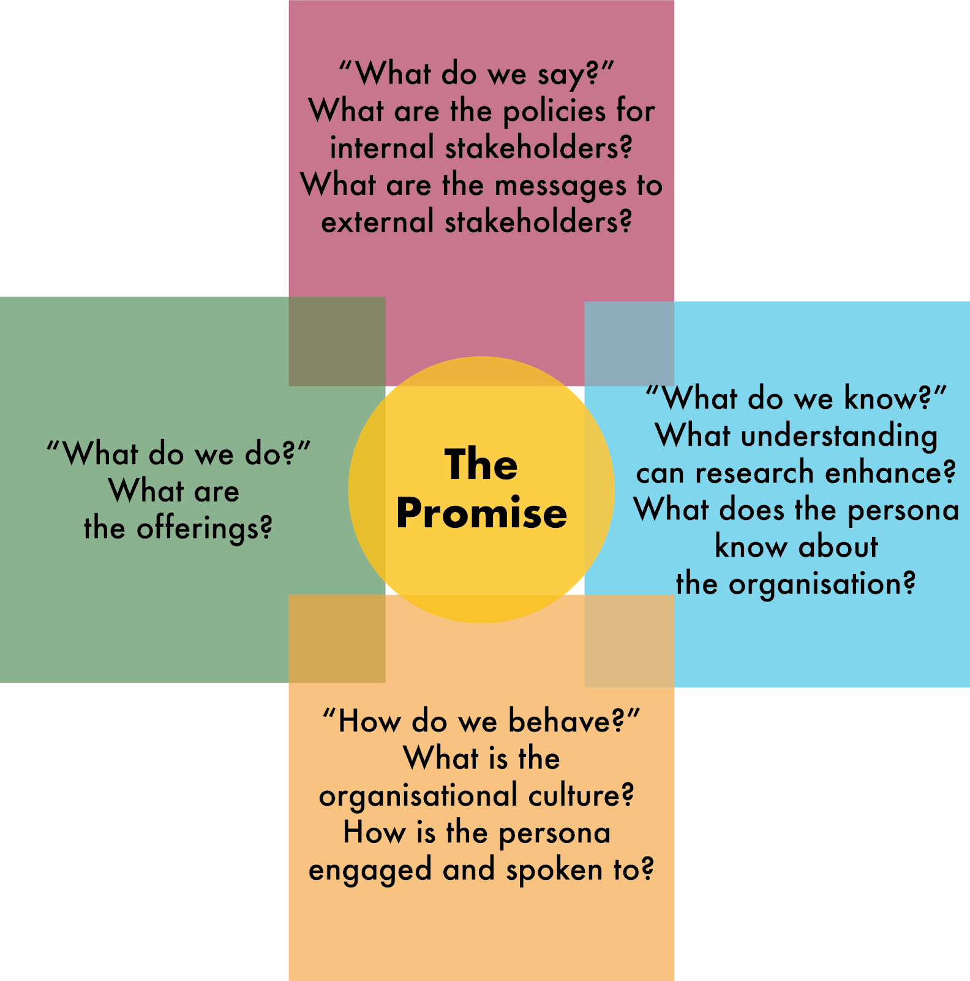

Embedding the promise to the persona within an organisation (after Cruz 2006)

Slide 6
Brand Equity
Definition: The intangible value perceived in a brand, fostering loyalty and advocacy.
Building Equity: Through interaction, increasing knowledge, guiding preference.
Example: Hyundai’s Genesis brand for luxury vehicles.
Brand Equity Pyramid: Awareness, value perception, emotional connection.

Slide 7
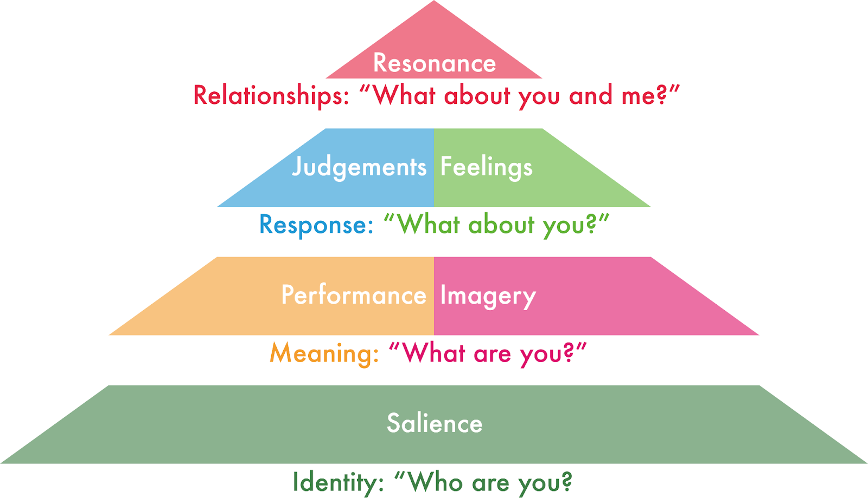
The brand equity pyramid (after Keller and Swaminathan 2020)

Slide 8
The Rise of Social Media–Based Brands
User-Generated Content (UGC): Reviews, videos, blogs by stakeholders.
Brand Co-Creation: Influenced by external stakeholders.
Engagement: Brands must listen and engage in conversations.
Challenges: Creating a personality for brands to connect with people.

Slide 9
Social Media Presence
Channel Selection: Based on persona preferences.
Customisation: Consistent naming and profile pictures.
Engagement: Through relevant social media channels like Facebook, X, TikTok, YouTube.
Example: Asus’s success with gaming laptops in China.

Slide 10
Developing a Network of Profiles
Interlinked Channels: Websites, social media, blogs to engage personas.
Two-Way Communication: Follow and share buttons to amplify content.
Tracking and Data Collection: Analyse which channels produce results.
Blogs: Central to content longevity and driving traffic.

Slide 11
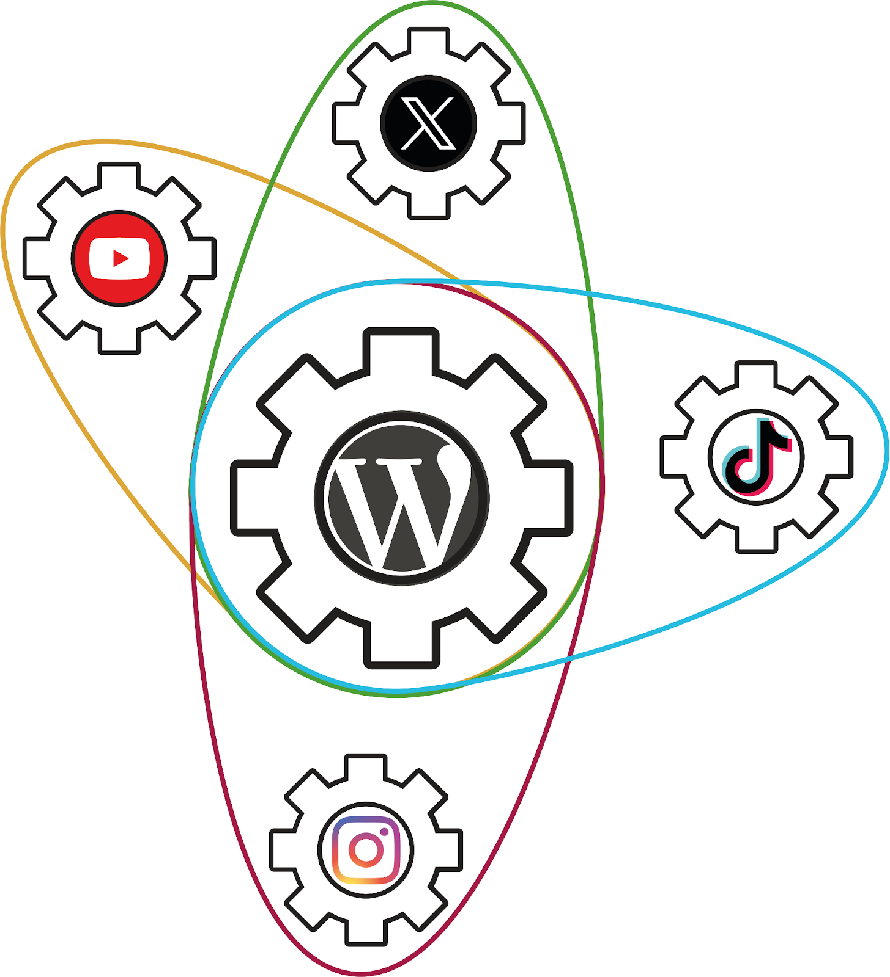
The centrality of a blog in an organisation’s digital presence

Slide 12
Paid, Owned, and Earned Media (POEM)
Owned Media: Websites, blogs, social media profiles.
Earned Media: External endorsements and positive word-of-mouth.
Paid Media: Advertisements, retargeting, paid endorsements.
Ethical Considerations: Transparency in paid endorsements.

Slide 13
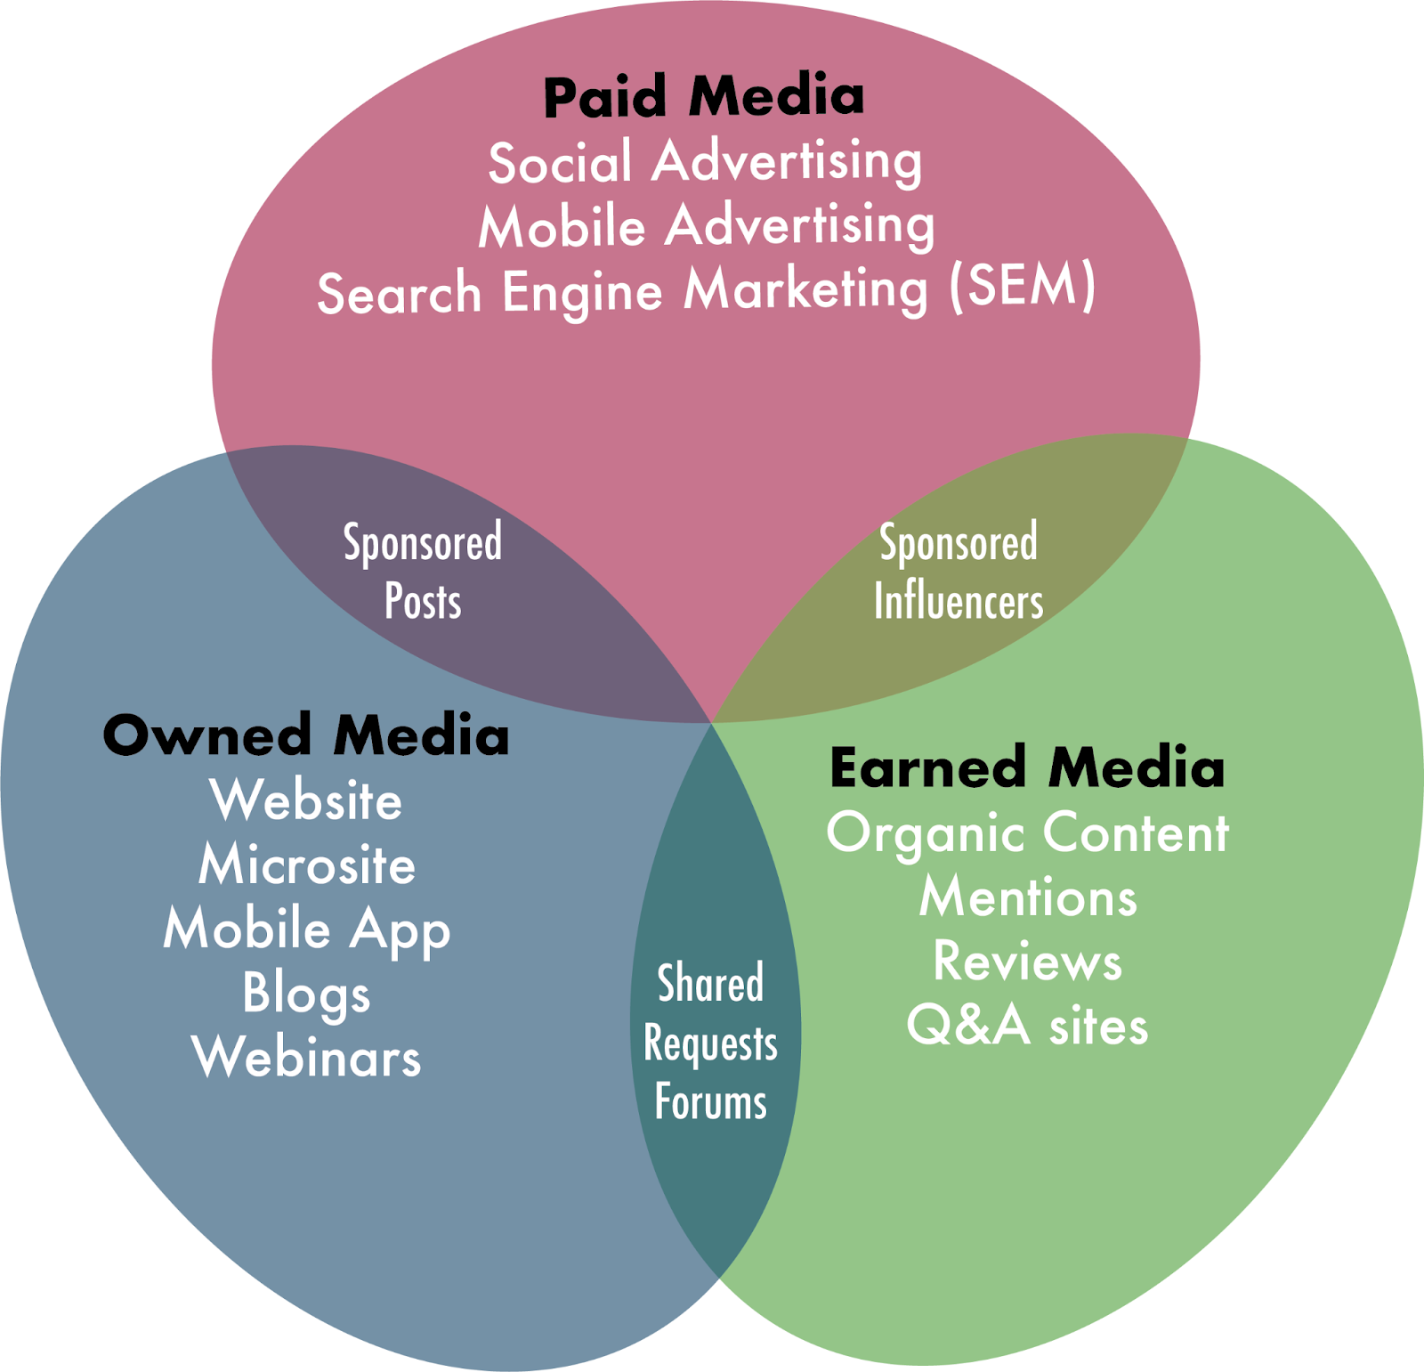
Paid, owned, earned media (POEM)

Slide 14
Building a Successful User Experience
Usability: Easy navigation, fast loading, mobile compatibility.
Positive Experience: Leads to engagement and brand advocacy.
User Experience Factors: Operability, aesthetics, trust, and usefulness.
Website Optimisation: Enhances stakeholder traffic and engagement.

Slide 15
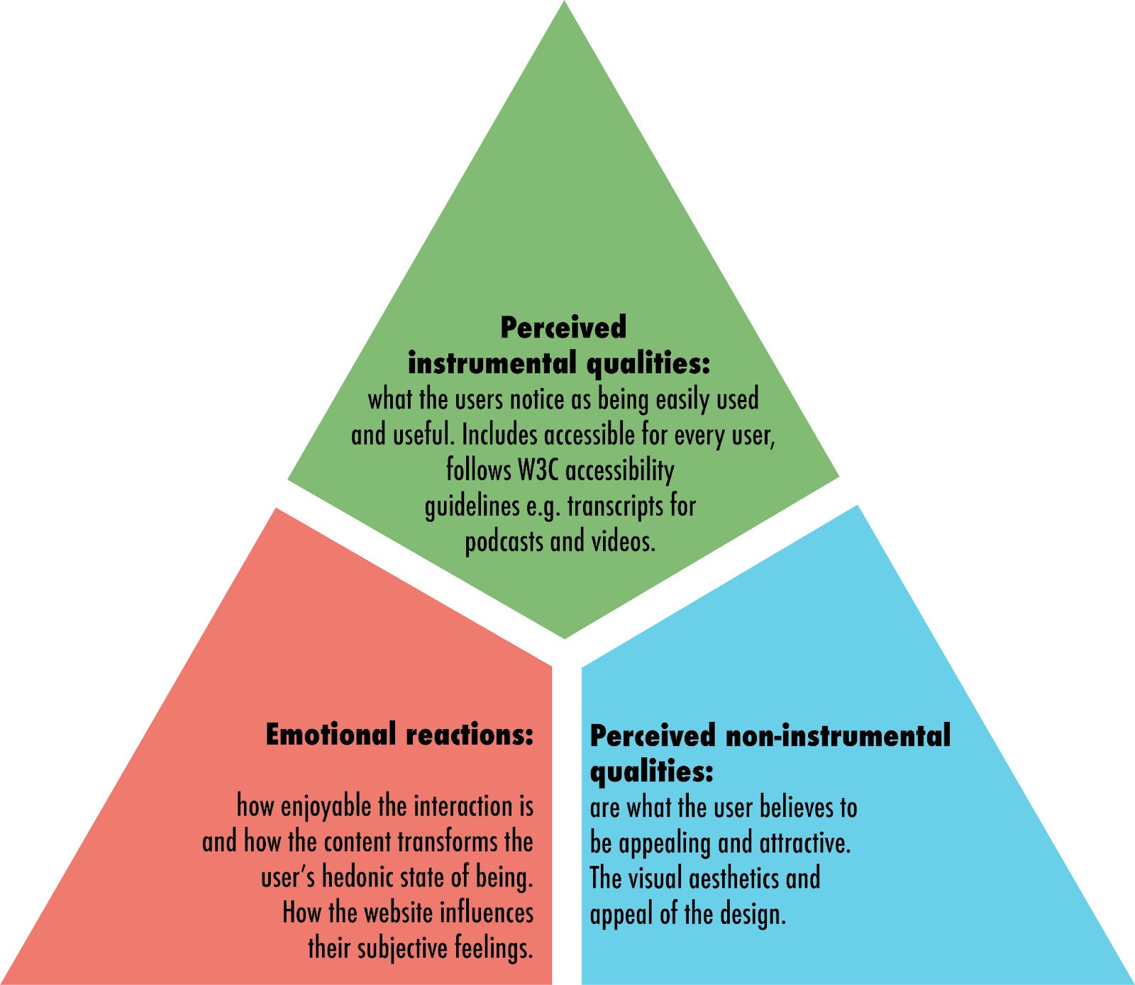
User experience factors (after Mahlke and Thüring 2007)

Slide 16
Principles of User Experience Design
Primary Audience: Search engine robots and human users.
Key Elements: Fast loading, clear call-to-action, functional internal search.
Mobile Usability: Compatibility with all devices, reducing data transfer.
Content Layout: Simple formatting, minimalistic design.

Slide 17
Usability Guide and Testing
Usability Steps: Planning, analysing, designing, testing, refining.
Issue Identification: User testing and severity ratings.
Accessibility: Web Content Accessibility Guidelines (WCAG) principles.
Focus: Perceivability, operability, understandability, robustness.

Slide 18
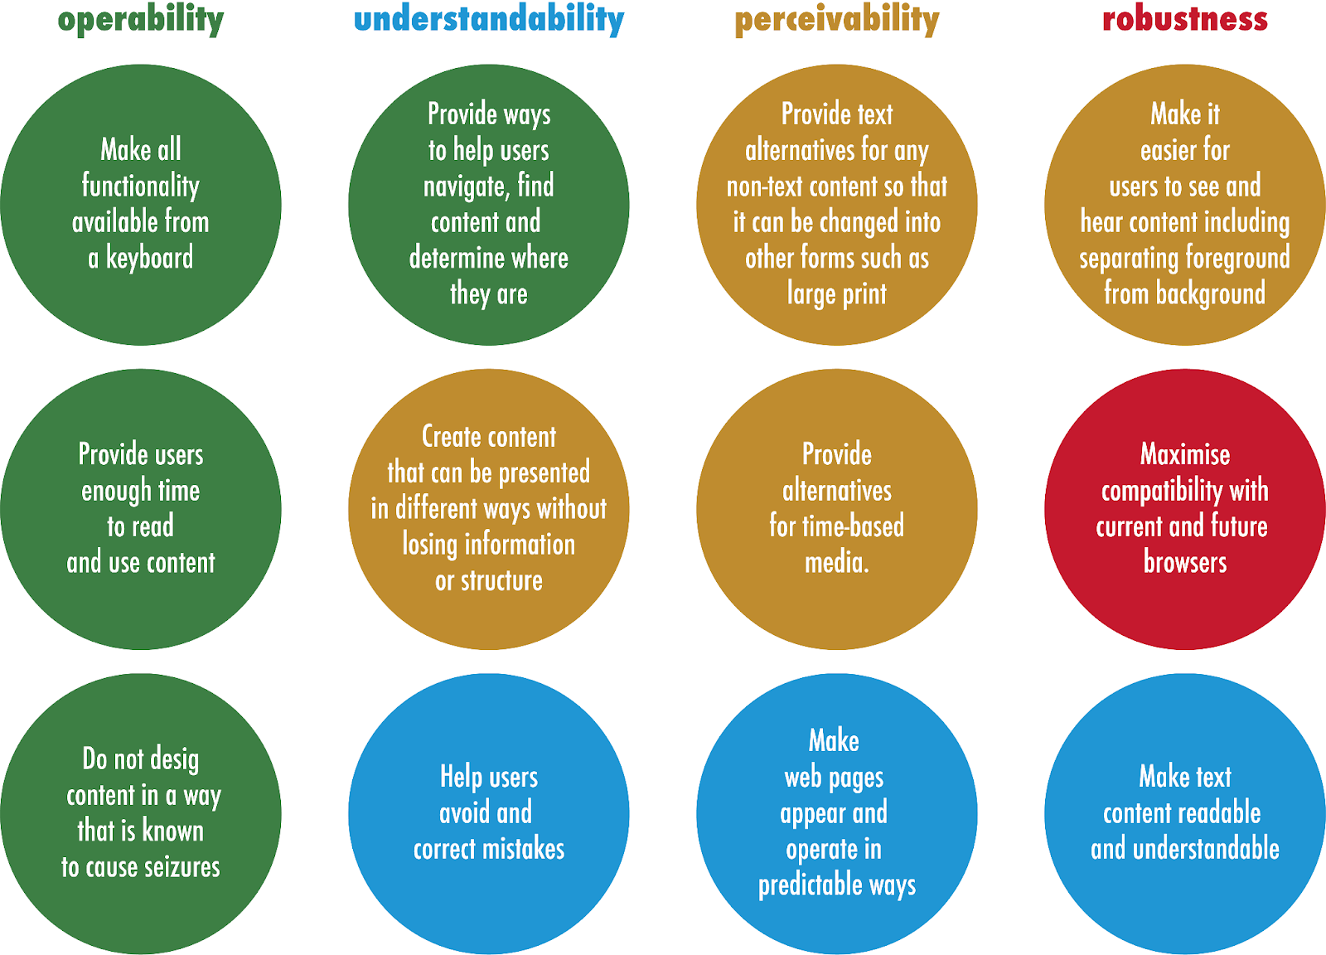
Guidelines for accessible web content (WCAG 2.1 and W3C)

Slide 19
Responsive Design
Definition: Optimal viewing experience on multiple devices.
Mobile Focus: Easy-to-read content, touch-based navigation.
Challenges: Simplicity, minimal data transfer.
Example: AppyPie’s code-free mobile app development platform.

Slide 20
Website Infrastructure
Domain Name: Selection and registration.
Content Management Systems (CMS): WordPress, integrating SEO plugins.
Web Development: From design to interactive website.
Keywords: Reflecting the organisation and persona needs.

Slide 21
Information Architecture
Organising Content: Structure and hierarchy based on keywords.
Site Map: Visual representation of website content.
Navigation: Menus and submenus for user-friendly experience.
Wireframes: Visual guides for page elements.

Slide 22
Content and Website Design
Visual Content: Combining images, videos, and text.
Engaging Stakeholders: Triggering senses and curiosity.
Language: Clear, concise, and easily understood.
Visual Hierarchy: Headings, subheadings, bold and italics for emphasis.

Slide 23
Summary
Digital Presence: Sum of digital channels and stakeholder activities.
Strategic Alignment: Organisation’s actions and value proposition.
Interaction and Engagement: Maximised through paid and earned media.
Website Optimization: Key to enhanced traffic and engagement.

