Slide 1

Unleashing Growth with Stakeholder-Centric Perspectives
Authors: Ana Cruz, Aleksej Heinze and Milanka Slavova

Slide 2

Learning Objectives
In this chapter, you will learn how to:
- Emphasise the role of stakeholder centricity and how it maximises results
- Identify the right stakeholders
- Recognise the importance of stakeholder satisfaction
- Design the persona journey
- Encourage an organisational culture of permanent growth hacking

Slide 3

Why Stakeholder-Centricity?
Change is constant in organisations and their environments.
Understanding evolving stakeholder needs and responding to dynamic conditions is crucial.
Meeting these needs builds trust and supports long-term sustainability.

Slide 4

Examples of Failure to Adapt
Blockbuster: Failed to adapt to on-demand streaming technology.
Tower Records: Did not keep pace with market changes like music piracy and streaming.
Pan American World Airways: Suffered irreparable reputational damage from a disaster.

Slide 5

Identifying the 'Right' Stakeholders
A stakeholder can be inside or outside the organisation, in the supply chain, a consumer, or hold a more indirect relationship.
Prioritisation is based on the value of the relationship and ease of interaction.

Slide 6

Stakeholder Pyramid
The Stakeholder Pyramid categorises stakeholders into
  Platinum
  Gold
  Iron
  Lead
Based on stakeholder value and ease of interaction.
Organisations should focus on turning Lead stakeholders into higher-value categories.

Slide 7
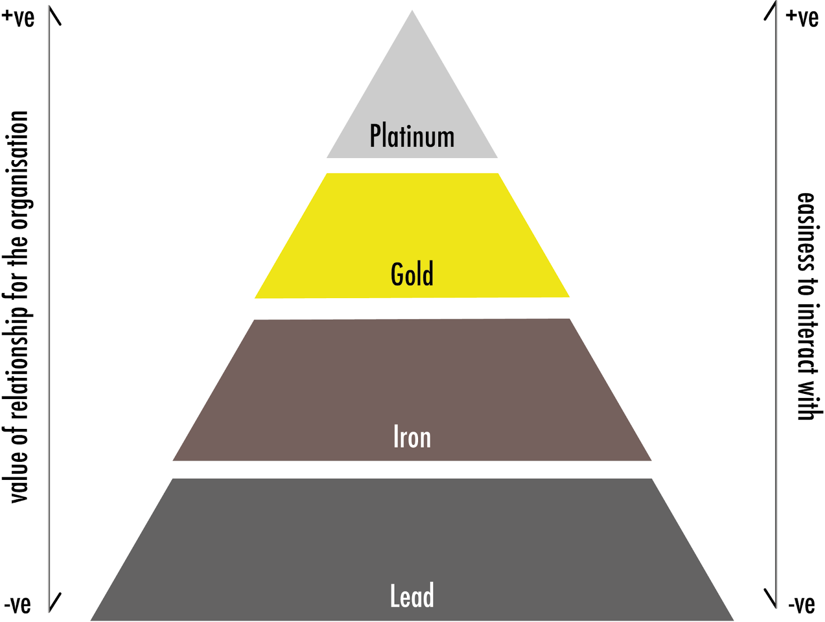

Stakeholder pyramid

Slide 8
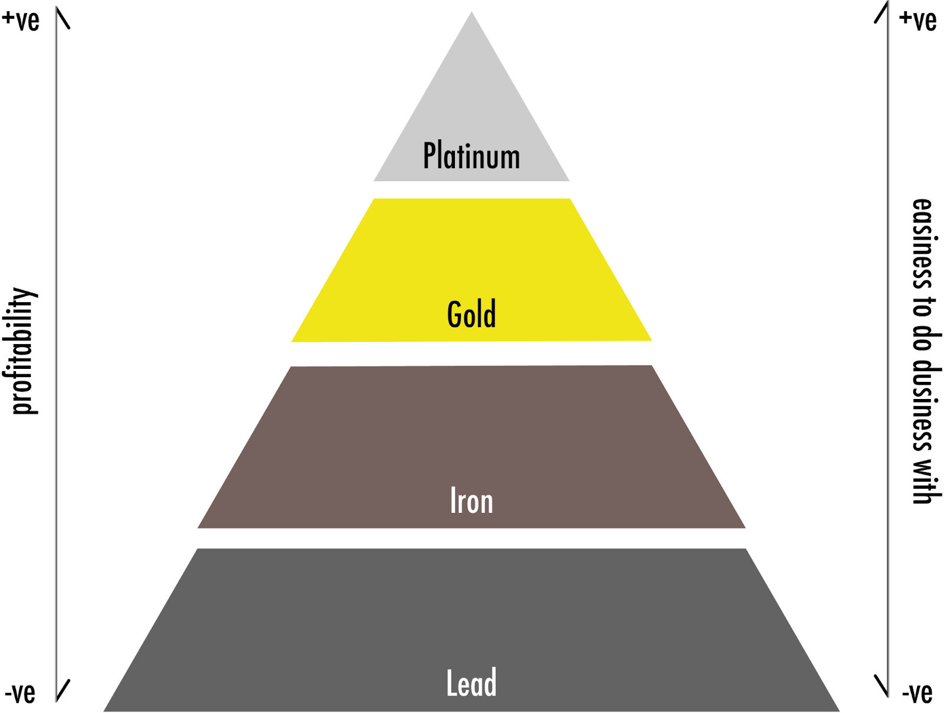
Customer pyramid (after Zeithaml et al. 2001)

Slide 9

Customer Lifetime Value (CLV)
CLV = Average Transaction Value (ATV) x Transactions Per Year (TPY) x Number of Years (NY)
It helps justify marketing investments by calculating long-term value from stakeholders.

Slide 10

Calculating CLV
Short-term CLV Example:
Investment: €5000
Sales: 4 at €1500 each
ROI = 20%
Long-term CLV Example:
Investment: $500
Sales: 30 at $10 each
Annual repeat purchases: 12
Customer lifetime: 12 years
CLV = $1440 per year, $17280 total

Slide 11

Customer Satisfaction (CSAT)
CSAT = (Number of positive responses / number of total responses) x 100%
It helps predict CLV and guide continuous improvement.

Slide 12
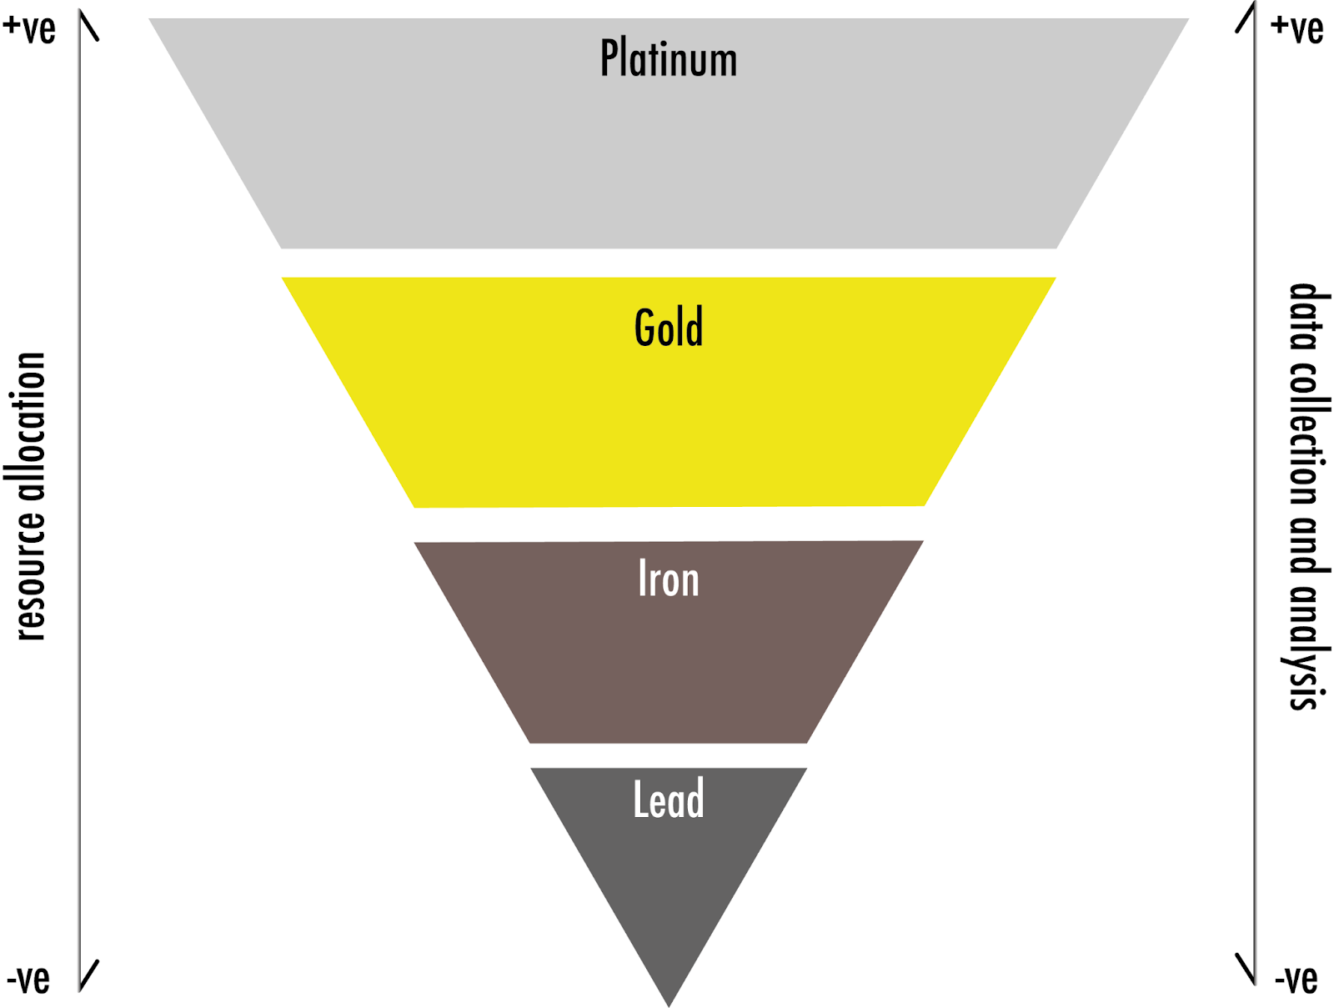
The inverted pyramid of effort and focus

Slide 13
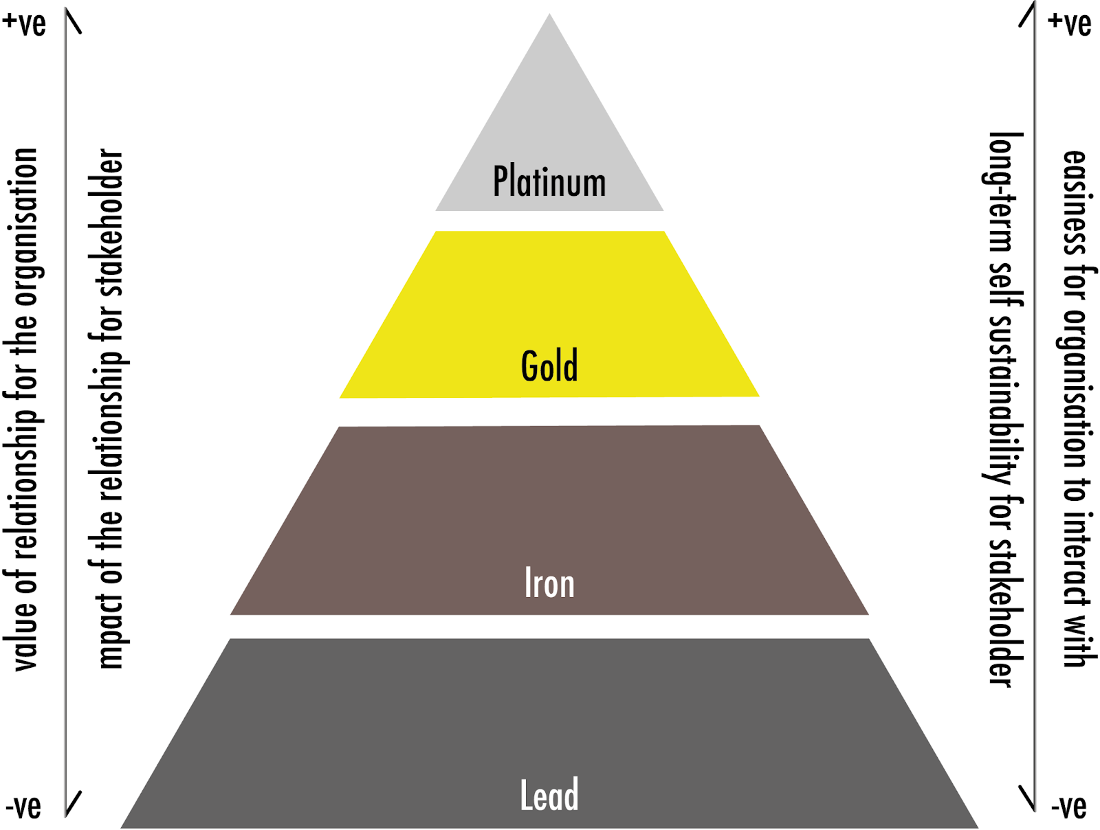
The stakeholder beneficiary pyramid

Slide 14
Donor Lifetime Value (DLV)
DLV = Average Donation Value x Average Frequency of Donations x Average Donor Lifetime
Useful for measuring the longevity of relationships with financial contributors.

Slide 15

A non-judgemental representation of the stakeholder beneficiary pyramid

Slide 16
Stakeholder-Centricity in Practice
Organisations should build a culture focused on stakeholder needs by:
1. Operationalising customer empathy
2. Hiring for stakeholder orientation
3. Facilitating direct interaction with stakeholders
4. Linking employee culture to stakeholder outcomes
5. Linking remuneration to stakeholder lifetime value
6. Democratising insights

Slide 17
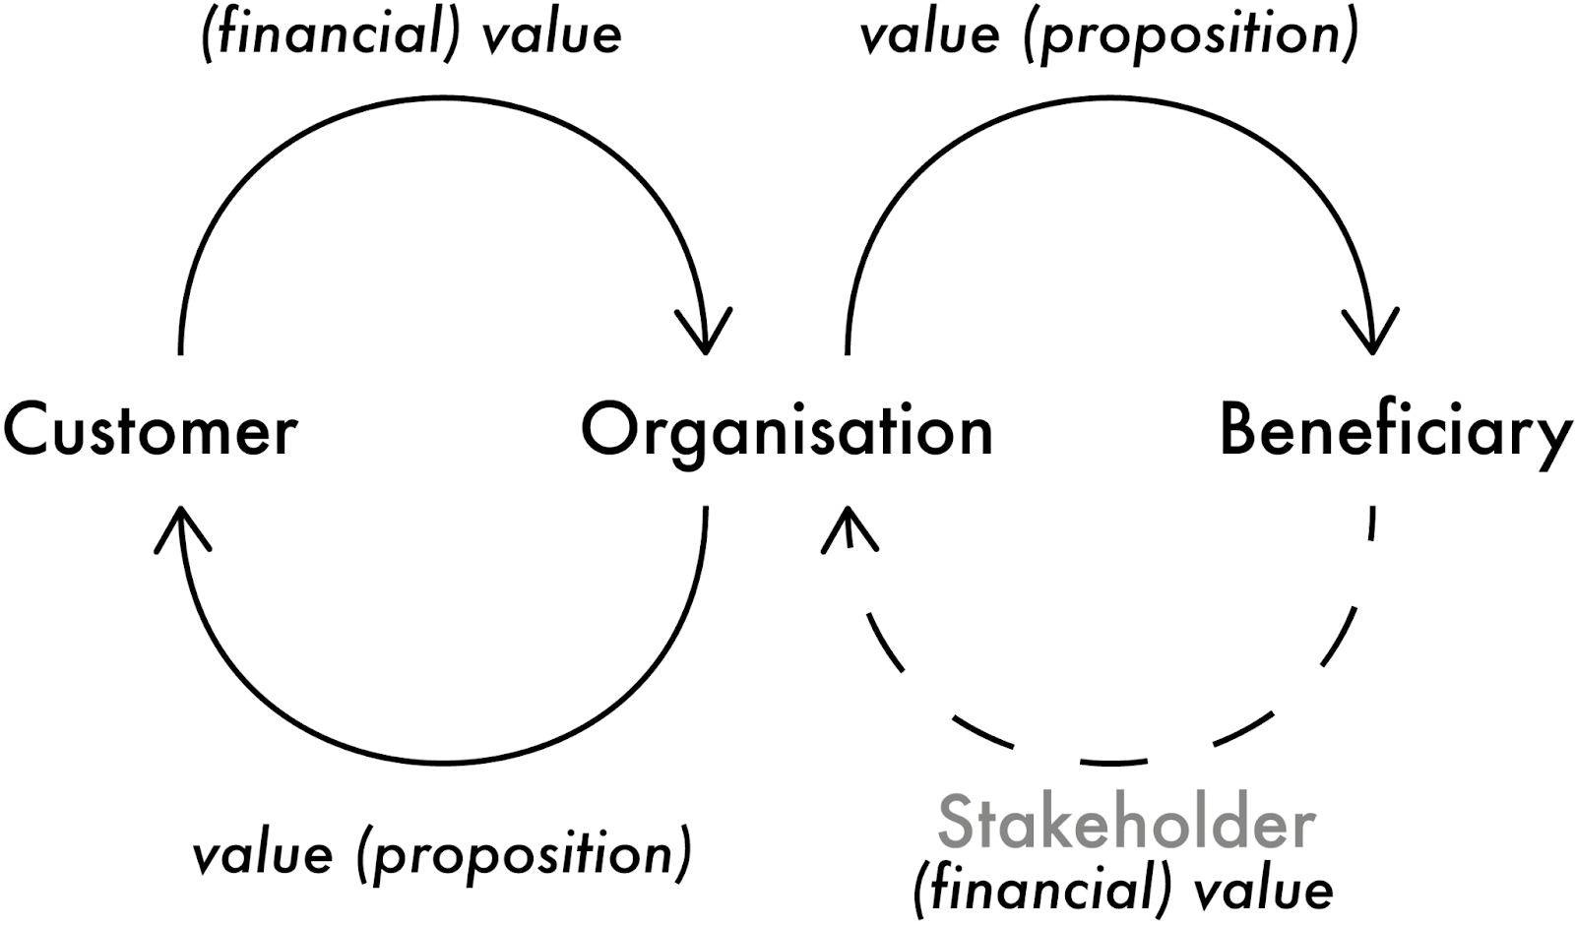
The simplified stakeholder-centricity perspective

Slide 18
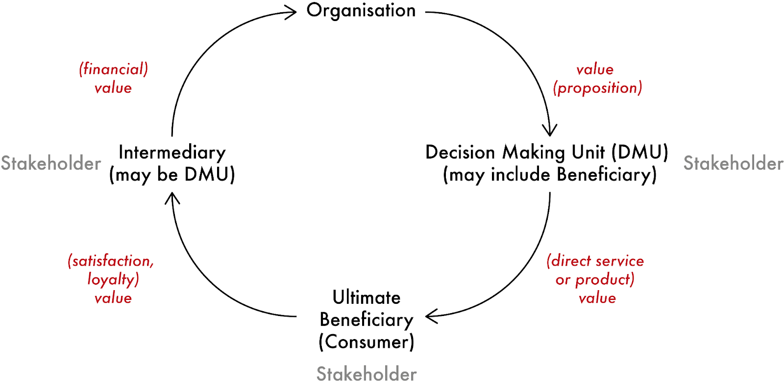
A generalised stakeholder-centricity perspective

Slide 19
Persona Journeys
Mapping stakeholder interaction with the organisation through a 'persona journey' helps identify specific channels and content to effectively reach and retain stakeholders.

Slide 20

AIDA vs. ZMOT Models
AIDA (Attraction, Interest, Desire, Action) is linear and ignores loyalty.
ZMOT (Zero Moment of Truth) focuses on four decision points:
  Stimulus
  ZMOT
  FMOT (First Moment of Truth)
  SMOT (Second Moment of Truth).

Slide 21

ZMOT Infinity Loop
Linking current stakeholder SMOT with future activities maximizes long-term relationships.
This approach encourages proactive engagement and expansion activities.

Slide 22
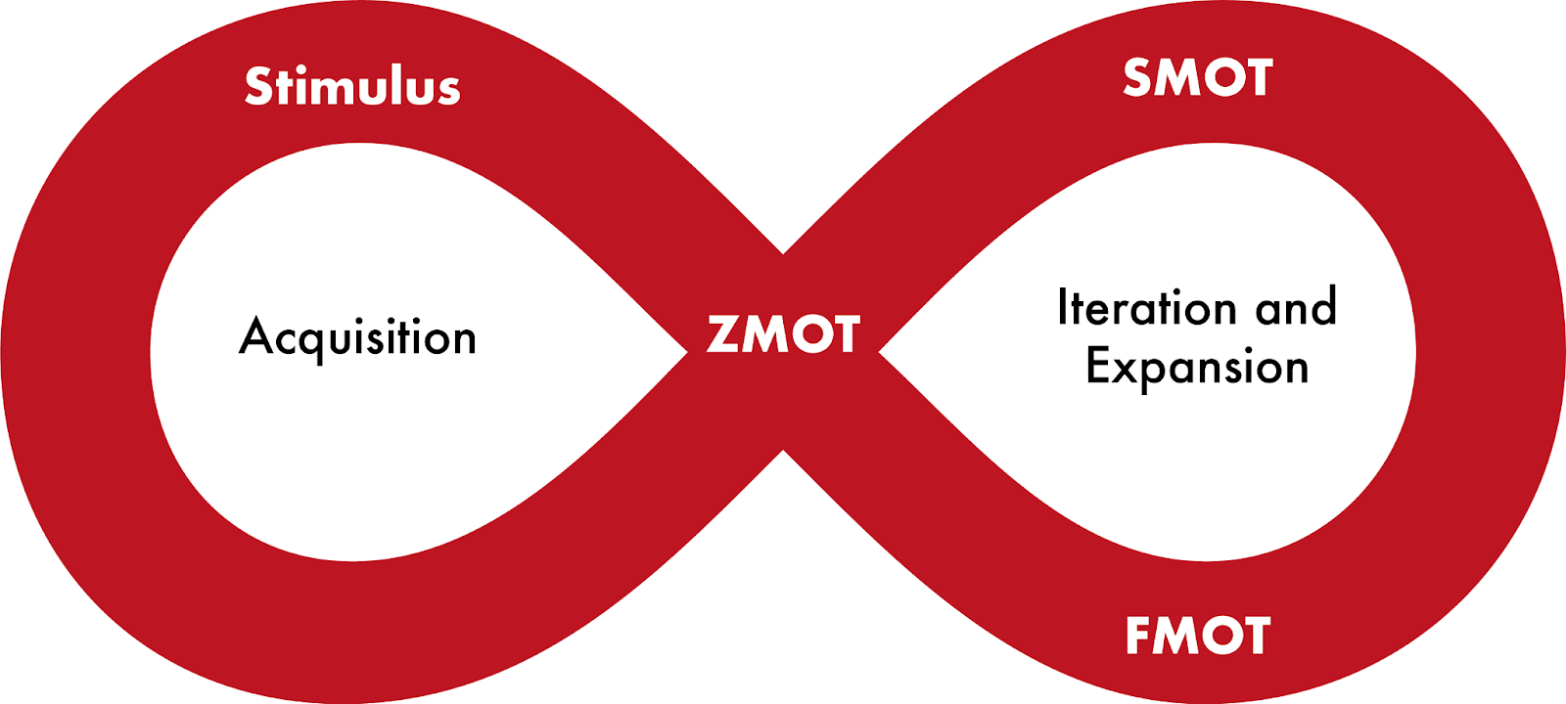
Stakeholder-centricity loop (after Pedowitz 2021)

Slide 23

Growth Hacking for Stakeholder-Centricity
Growth hacking combines creative marketing, data analysis, and coding with a focus on growth.
It involves multi-department teams working on the entire persona journey.

Slide 24
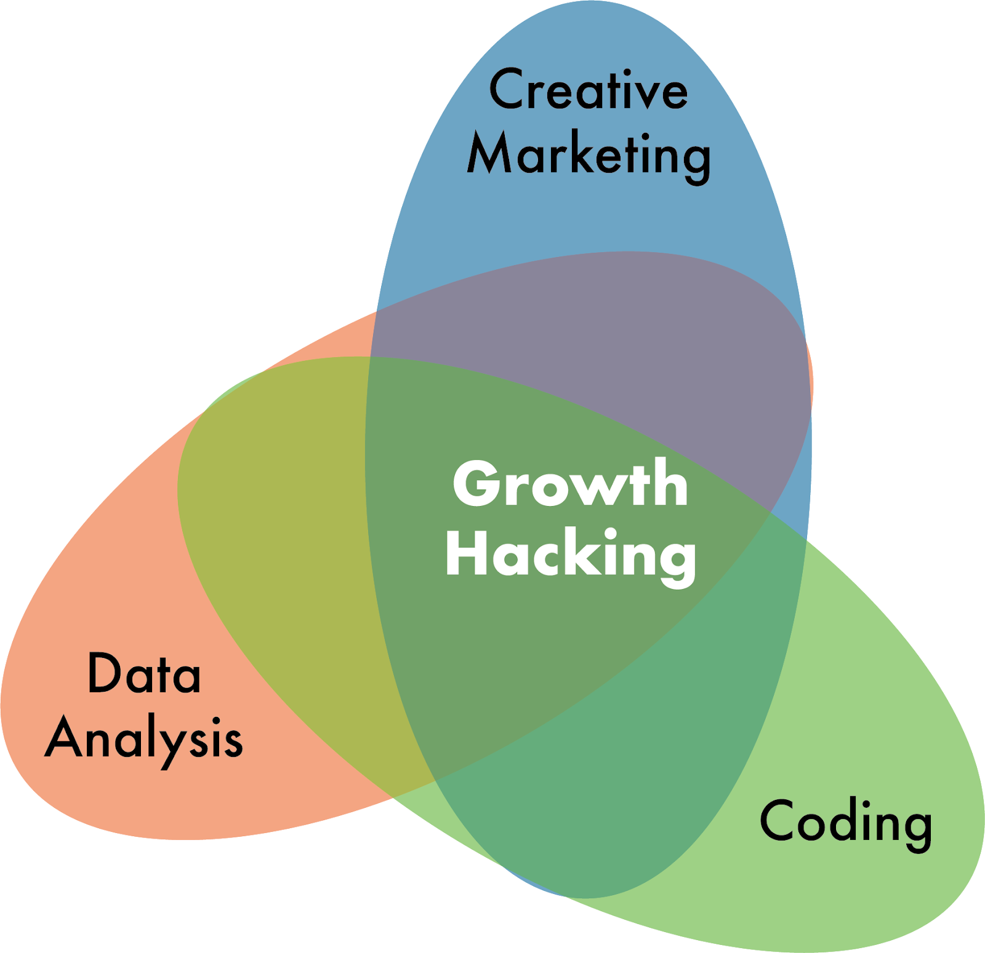
The elements of growth hacking

Slide 25

Examples of Growth Hacking Techniques
1. Hotmail's signature call to action
2. Dropbox's gamification of the onboarding process
3. Facebook's user tagging notifications

Slide 26
Summary
Stakeholder-centricity, persona journey planning, and growth hacking are crucial for sustainable organisational growth.
These approaches ensure that organisations remain relevant and effectively meet stakeholder needs.

