Slide 1
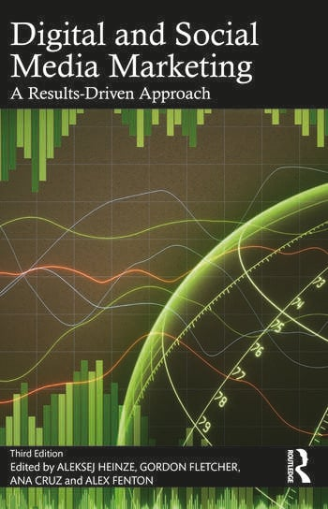
Horizon Scanning for Insights
Authors: Aleksej Heinze, Ana Cruz and Milanka Slavova

Slide 2

Learning Objectives
Plan for digital transformation through the HINGES acrostic
Use horizon scanning to identify potential technological disruption and future opportunities
Carry out a digital health check
Use insights to understand a persona
Use insights to inform strategy

Slide 3
Importance of Monitoring the External Environment
Organisations are collecting, processing, and storing increasingly large amounts of data
What other organisations do with their data can significantly influence your organisation
Examples: Reviews on Glassdoor, innovative use of data creating new value for stakeholders

Slide 4

Risks in the External Environment
Compliance with General Data Protection Regulation (GDPR)
Legal obligations and fines for non-compliance (e.g., €4 billion in fines from 2018-2023)
Dynamic legal factors influencing data collection, storage, and use

Slide 5

VUCA Environment
Definition: Volatility, Uncertainty, Complexity, Ambiguity
External environment characterised by VUCA due to reliance on data
Proactive identification and analysis of external forces

Slide 6
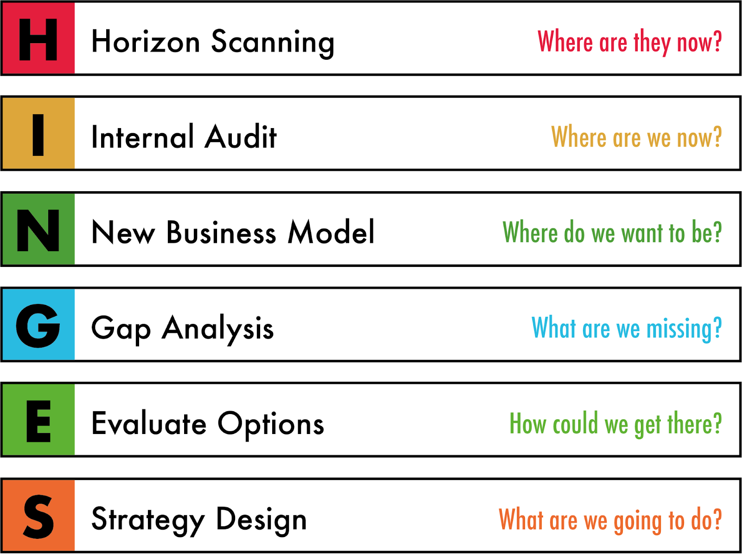

The HINGES Acrostic

Slide 7

Horizon Scanning
Proactive and systematic exploration and analysis of the external environment
Identifies opportunities, emerging trends, potential disruptions
Can focus on short, medium, or long-term impacts

Slide 8

Environment Scanning vs. Horizon Scanning
Environment Scanning: Focuses on the immediate future (1-5 years), uses PESTEEL analysis
Horizon Scanning: Stakeholder-centric, considers long-term trends and disruptions beyond PESTEEL factors (5+ years)

Slide 9

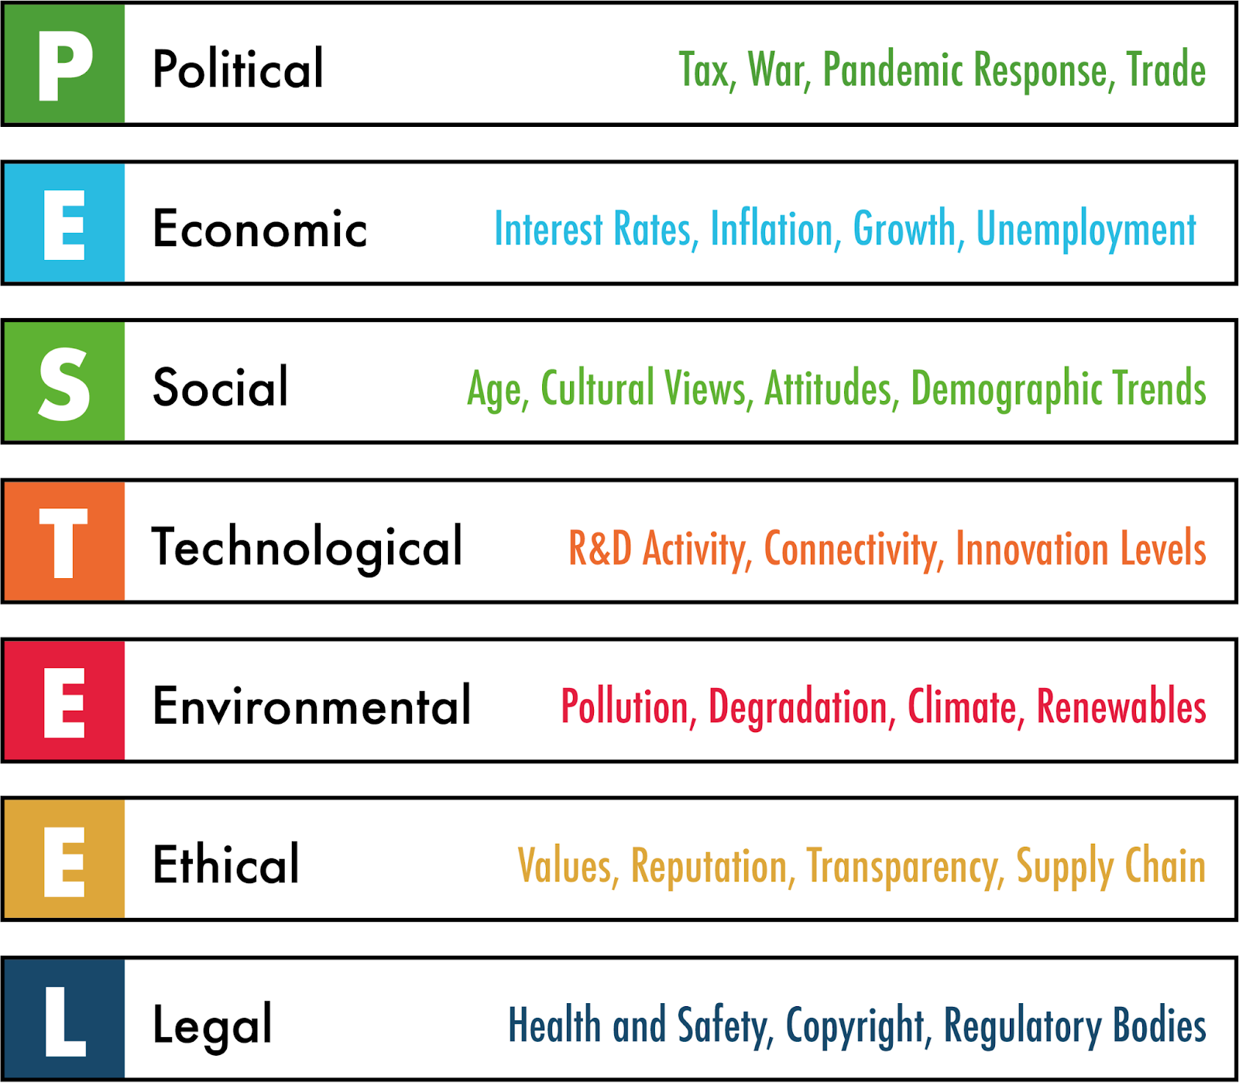
PESTEEL Analysis

Slide 10

Case Study: Generative AI
Generative AI as a disruptive technology trend
Example: Google’s response to Microsoft integrating generative AI into Bing
Importance of market monitoring and internal R&D

Slide 11

Internal Audit
Assessment of digital maturity and readiness for continuous change
Elements: People, Data, Communications, Software, Processes, Hardware
Organisational digital maturity model

Slide 12
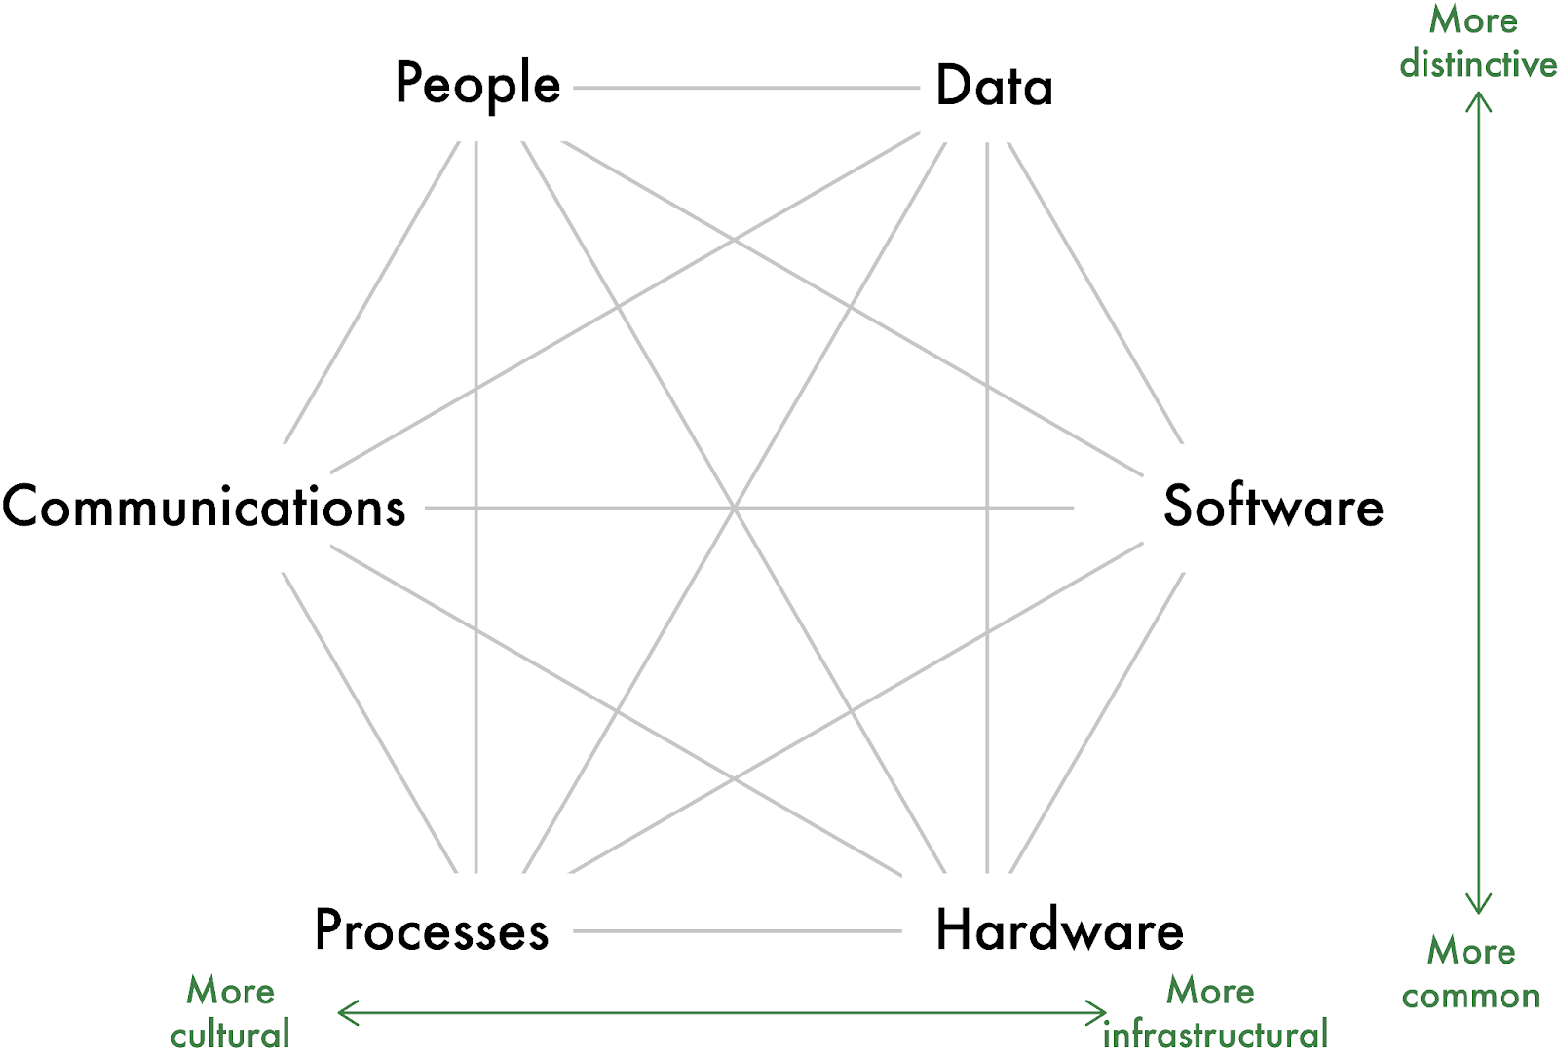
The internal view of an organisation as a system (Fenton et al. 2020)

Slide 13

Digital Maturity Model
Diagnostic tool for assessing an organisation’s digital maturity
Levels range from limited operational need to visionary perspective with full data integration

Slide 14
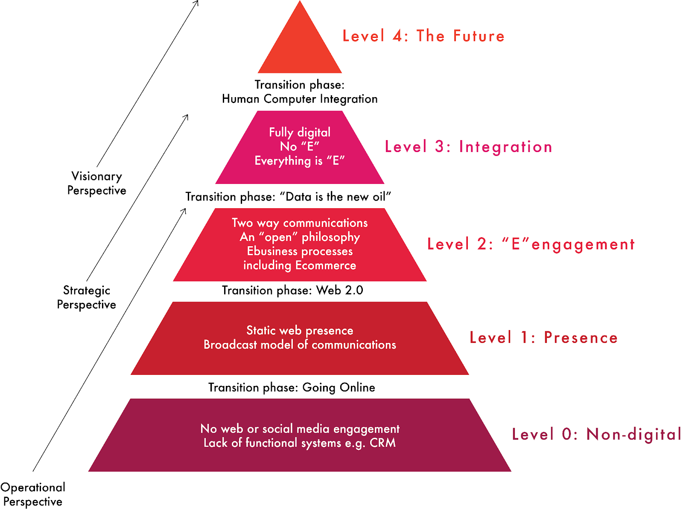
An organisational digital maturity model

Slide 15
Characteristics of Digitally Mature Organisations
Preparedness to take risks and invest in digital initiatives
Clear vision from senior leadership that engages the entire organisation

Slide 16
New Business Models
Business model: How an organisation creates and captures value
Business strategy: Methods used to realise the business model
Example: Rolls Royce’s servitisation model

Slide 17

Business Model Canvas
High-level representation of an organisation’s business model
Nine building blocks: Customer segments, Channels, Customer relationships, Key resources, Key activities, Key partners, Revenue streams, Cost structure, Value proposition

Slide 18
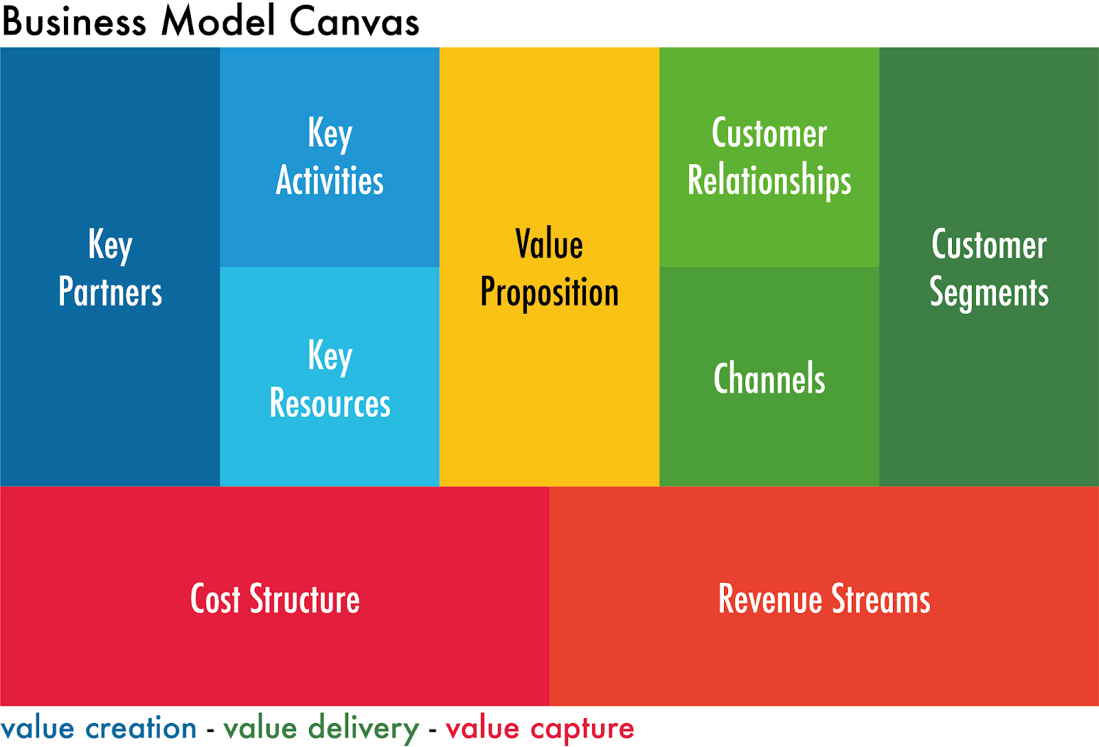
A business model canvas (after Osterwalder and Pigneur 2010)

Slide 19
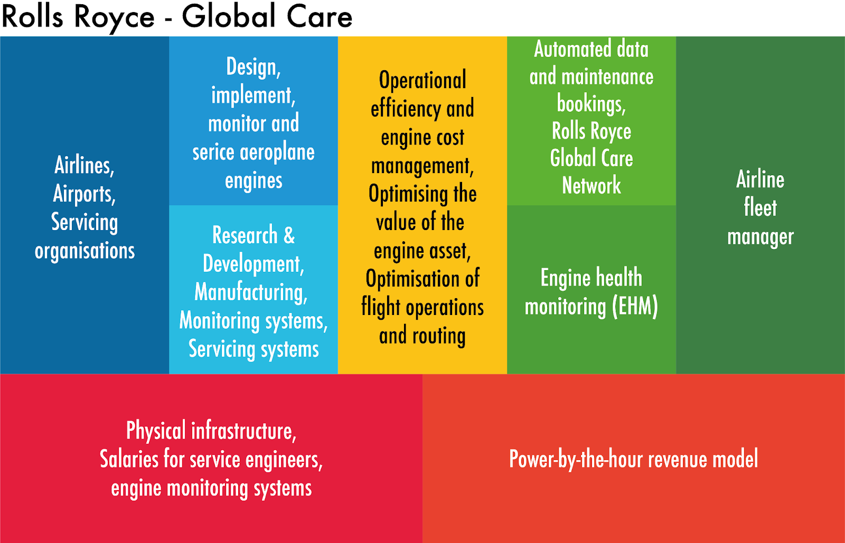
Simplified business model canvas for Rolls Royce Global Care (after Smith-Gillespie et al. 2018)

Slide 20
Gap Analysis
Review of existing capabilities and alignment with desired future state
Emphasis on gaps in people and data skills
Kübler-Ross change curve

Slide 21
Kübler-Ross Change Curve
Stages of change: Shock, Denial, Frustration, Depression, Experiment, Decision, Integration
Importance of supporting stakeholders through change stages

Slide 22
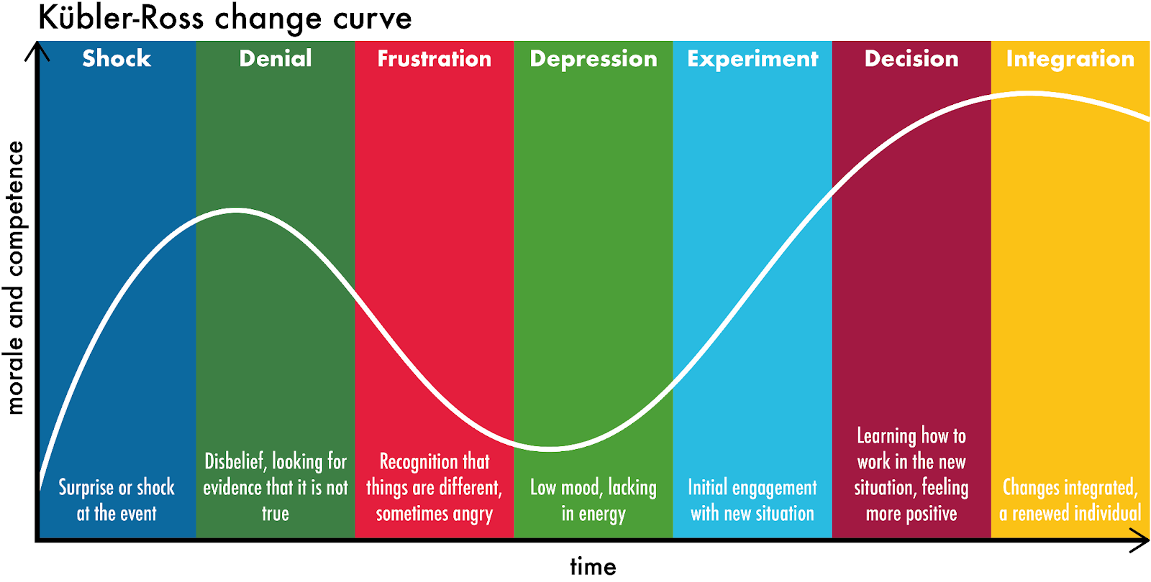
The Kübler-Ross change curve (after Kübler-Ross 1969)

Slide 23
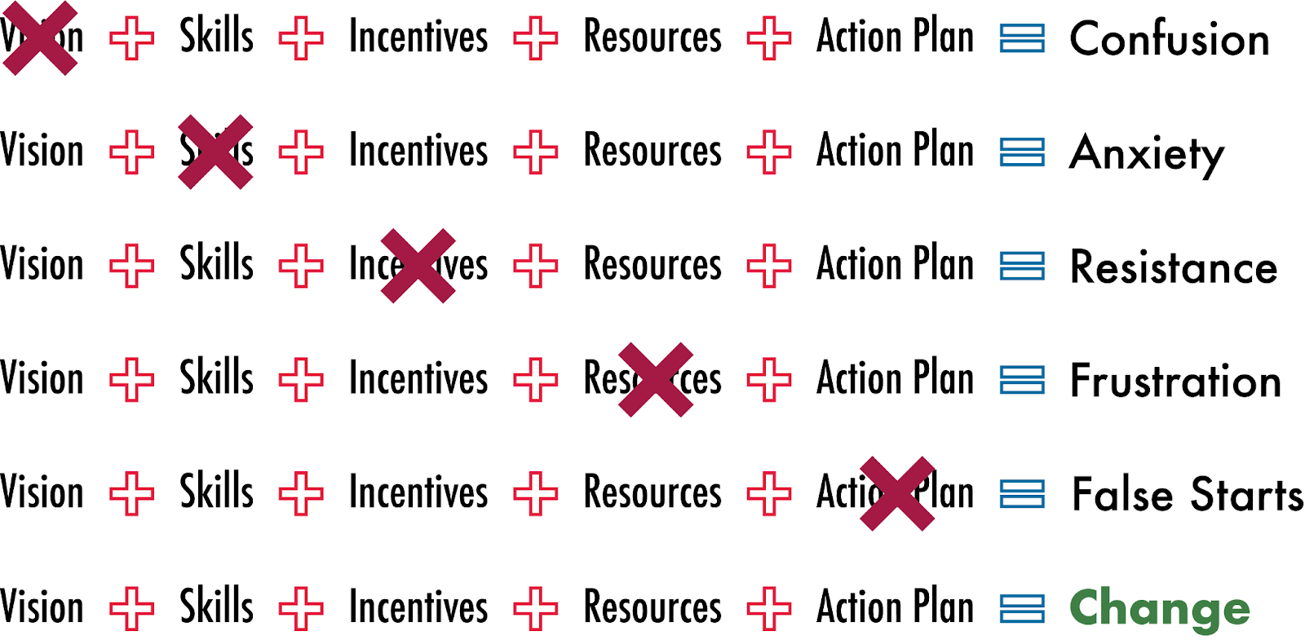
Managing complex change (after Lippit 1987)

Slide 24
Evaluation of Options
Identifying the most suitable option for bridging gaps
Core ingredients for successful change: Vision, Skills, Incentives, Resources, Action plan
Role of marketing in evaluating external situation

Slide 25
Strategy Planning
Development of a strategic plan based on evaluated options
Marketing strategy defines stakeholder engagement, content, channels, and data
Documentation of the persona journey

Slide 26
Summary
Importance of horizon scanning in digital transformation
HINGES as a structured approach to strategic planning
Continuous engagement and adaptation to external environment

