Slide 1

The Combined Power of Qualitative and Quantitative Insights
Authors: Quentin Isselé, Aleksej Heinze and Alex Fenton

Slide 2
Introduction
In marketing, data collection is vital.
Qualitative data explains 'why' and 'who', while quantitative data answers 'how much' and 'how many'.
Combining both types offers comprehensive insights.

Slide 3
Qualitative vs. Quantitative Data
Qualitative Data:
Attributes or characteristics
Answers 'why did this happen?' and 'who did this?'
Quantitative Data:
Countable and measurable
Answers 'how much?', 'when did this happen?' and 'how many?'

Slide 4
The Helicopter Analogy
The helicopter analogy explains data perspectives:
At high levels, quantitative data provides a broad view.
As it descends, qualitative data offers detailed insights.
Combining both perspectives ensures a comprehensive understanding.

Slide 5
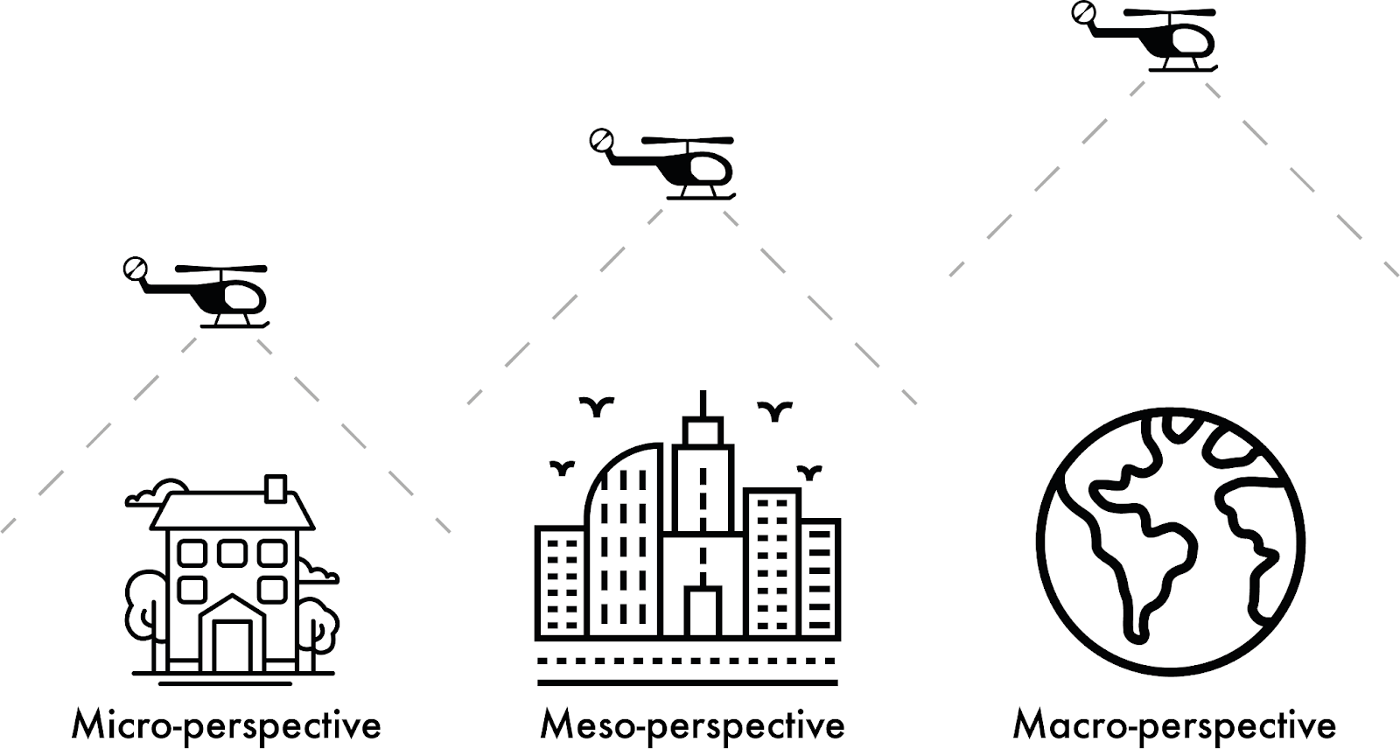

The macro, meso and micro helicopter

Slide 6
Netnography
Netnography is adapted from ethnography to study online communities.
It involves observing social media interactions to understand personas.
Advantages: Speed, low cost, and natural observation.

Slide 7
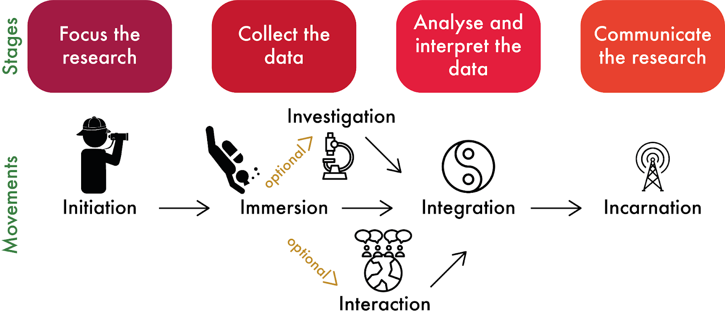
The four stages and six movements of netnography (adapted from Kozinets 2020)

Slide 8
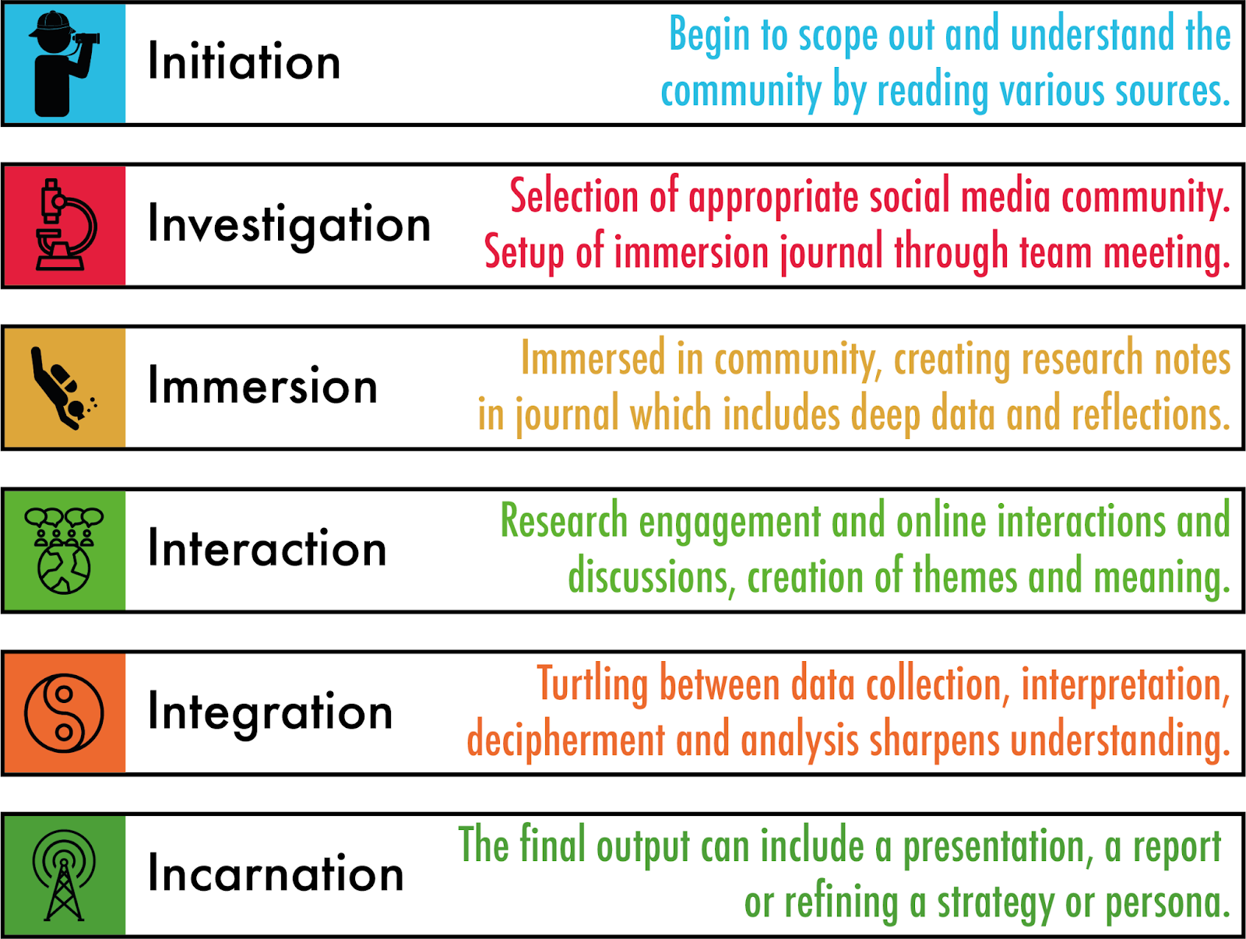
The six procedural movements of netnography (after Kozinets 2020)

Slide 9
Social Network Analysis (SNA)
SNA examines the structure and interrelations within social networks.
Identifies key influencers, social capital, and word-of-mouth dynamics.
Tools: NodeXL (data gathering) and Gephi (visualisation).

Slide 10
Branding Metrics
Branding metrics quantify social sentiment around a brand.
Key measures: Awareness, sentiment, and loyalty.
Example: Brand lift measures changes in perception due to advertising.

Slide 11
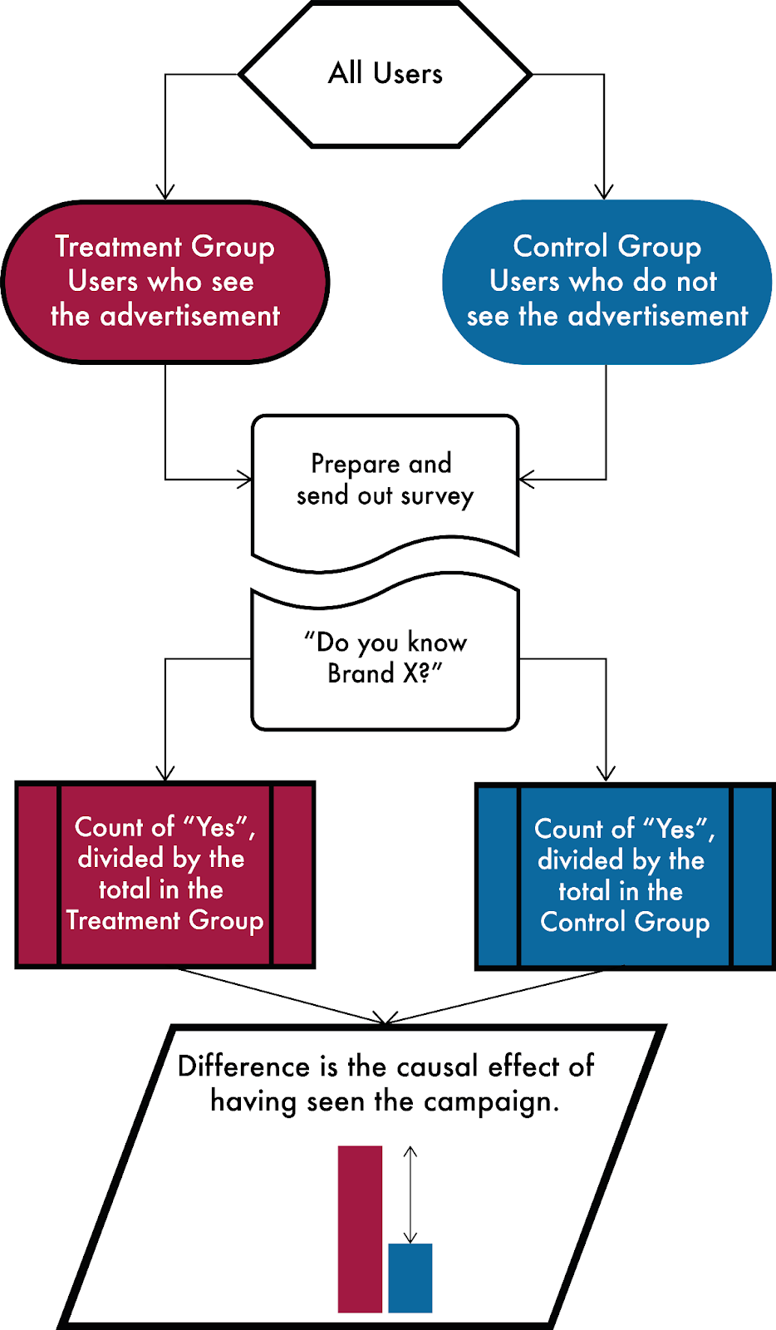
Identifying brand lift through a randomised control trial

Slide 12
Tracking and Analytics
Tracking user behavior is crucial for optimising marketing efforts.
Key metrics: Impressions, clicks, conversion rates.
Tools: Google Analytics for web and app data tracking.

Slide 13
Case Studies
Example 1: Squid Game's viral success on social media.
Analysis of social media activity showed community-driven influence.
Example 2: Oort Planet Care's campaign tracking using Instagram and Google Analytics.

Slide 14
Summary
Combining qualitative and quantitative data provides comprehensive insights.
Tools like netnography and SNA enhance understanding of audiences.
Tracking and analytics ensure data-driven decision-making for marketing success.

