Slide 1

Crafting Projects and Planning Campaigns
Author: Anna Tarabasz

Slide 2
Overview
This chapter breaks down strategy and long-term visions into smaller, manageable campaigns.
Common project management techniques such as Gantt Charts, Risk Assessment, Iron Triangle of Project Management, ABCD reporting, and RACI matrix are introduced.
Emphasizes the importance of good documentation for learning from campaign successes and failures.

Slide 3
Learning Objectives
Translate strategic objectives into project campaigns
Understand the planning of marketing campaigns
Document projects using common project management tools and techniques

Slide 4
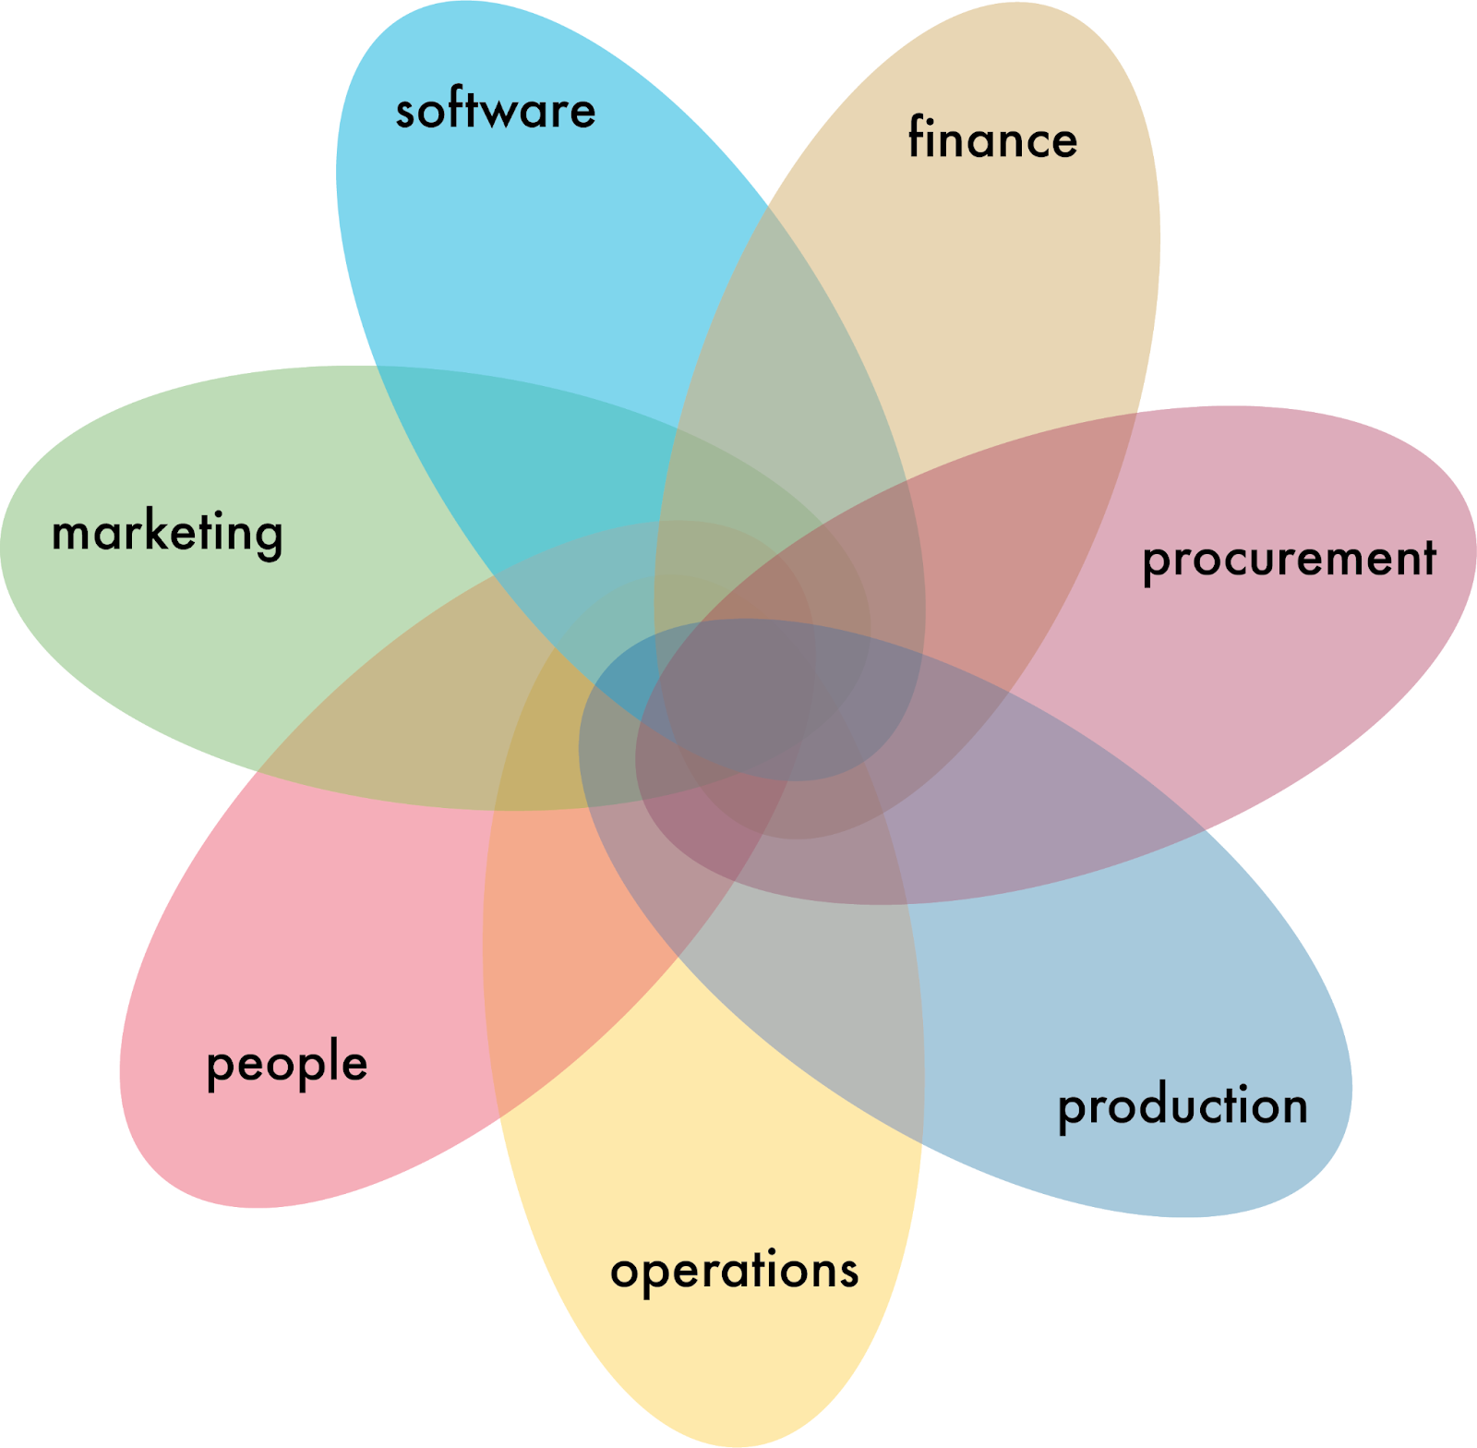

The influence of marketing actions across an organisation

Slide 5
Managing Marketing Projects
'Fail to plan, plan to fail' applies to marketing strategies
Proven project, programme, and portfolio management practices improve success
AI tools are increasingly supporting project management

Slide 6
AI and Project Management
AI expected to handle most project management tasks by 2030
AI tools can generate Gantt Charts, risk assessments, and scheduling calendars
High-quality inputs are essential for useful AI outputs

Slide 7
Project Management Methodologies
PRINCE2: Popular in the UK for controlled environments
Das V-Modell: Preferred for digital projects in Germany
PMBOK: Widely used, with variations like Agile, Scrum, Kanban, Lean, Six Sigma

Slide 8
Agile Methodology
Emphasizes developing small, functional elements quickly
Interactive and flexible approach
Popular in software development

Slide 9
Scrum Methodology
Linked to Agile methodology
Supports team collaboration and communication
Includes sprints with time-boxed iterations and daily stand-up meetings

Slide 10
Kanban Methodology
Focuses on visualizing work progress
Uses boards and cards to move tasks through different stages
Emphasises task-driven project delivery

Slide 11
Lean Methodology
Originated from Toyota production line system
Focuses on removing waste and improving efficiency
Aims to create value for stakeholders

Slide 12
Six Sigma Methodology
Emphasizes reducing defects and errors
Data-driven methodology using statistics
Identifies and predicts areas for improvement

Slide 13
Tools for Project Management
Common tools: Microsoft Project, Primavera, Jira, Confluence
Web-based options: Trello, Asana, Instagantt, Smartsheet, Katana
Basic tools: Spreadsheets, Google Docs, ChatGPT

Slide 14
The Iron Triangle of Project Management
Consists of scope, time, cost, and quality
Changes in one aspect affect the others
Helps define project success and key priorities

Slide 15
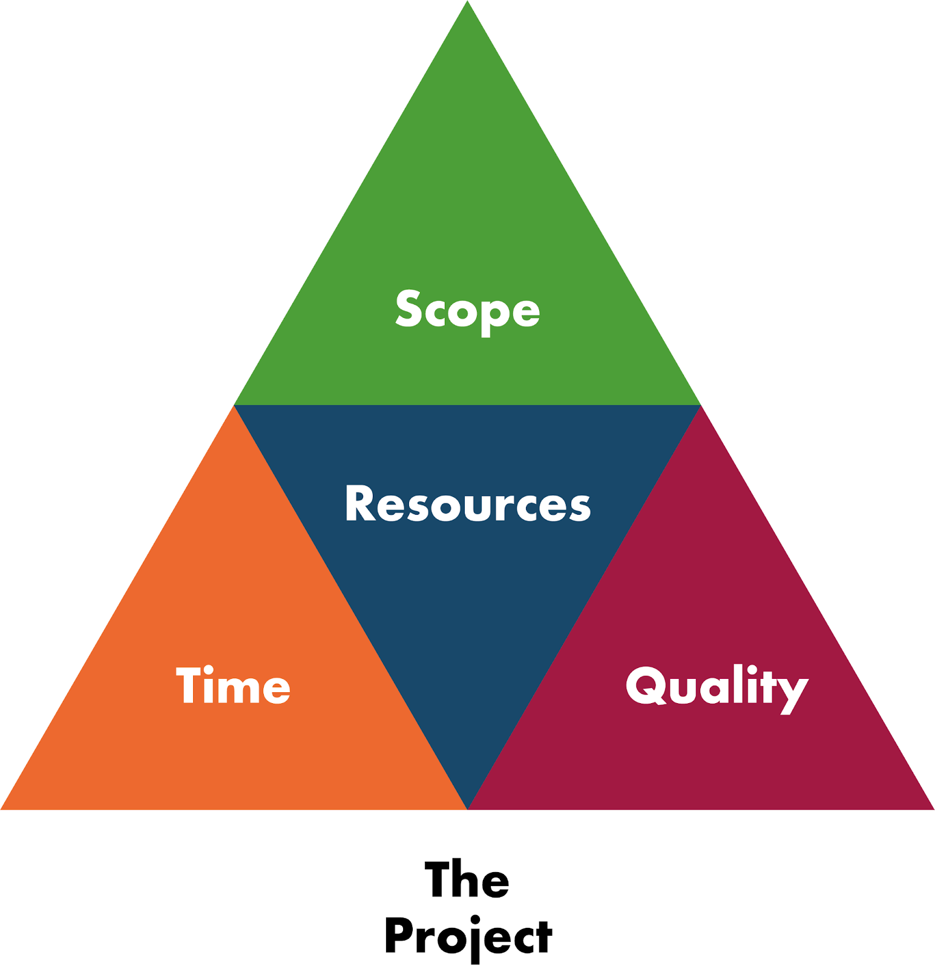
The Iron Triangle of Project Management

Slide 16
Action Learning Cycle
Four phases: Plan, Act, Observe, Reflect
Key for implementing and improving projects
Helps adapt to changes in the external environment

Slide 17
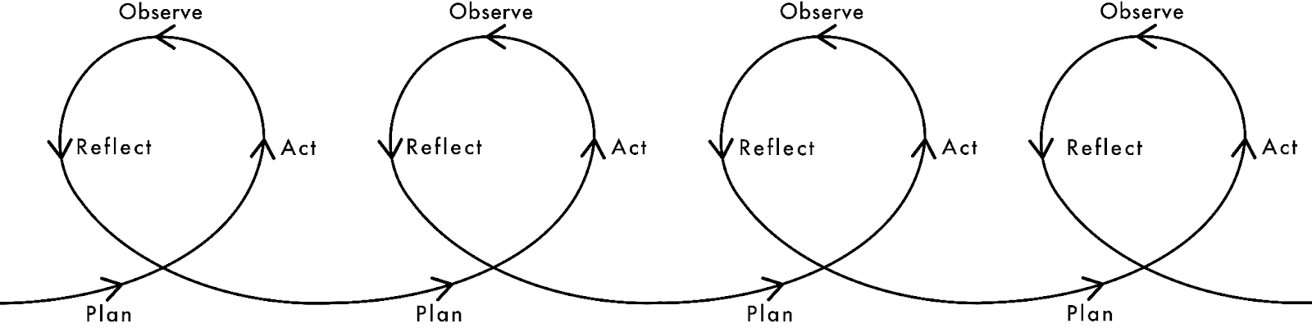
Action learning cycle Iterations

Slide 18
Setting Project Objectives
Use SMART objectives and KPIs
Align short-term campaign goals with strategic objectives
Use consistent tools and datasets for year-over-year comparability

Slide 19
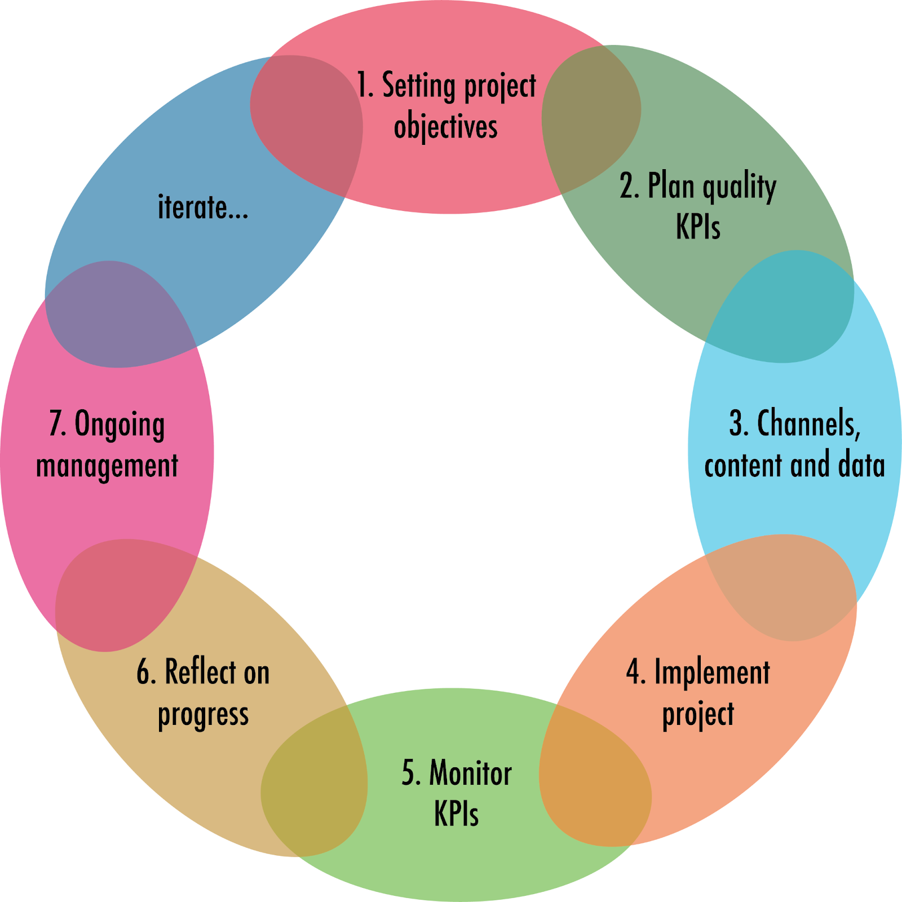
Project management cycle for marketing

Slide 20
Project Scheduling
Gantt charts for visualising project timelines
Work schedule management to maintain timelines
Critical path identifies the shortest time frame for project completion

Slide 21
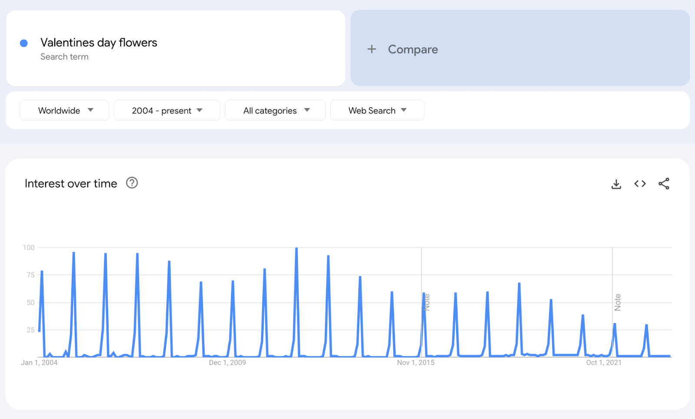
Seasonality for “Valentines day flowers” from Google Trends (Google and the Google logo are trademarks of Google LLC).

Slide 22
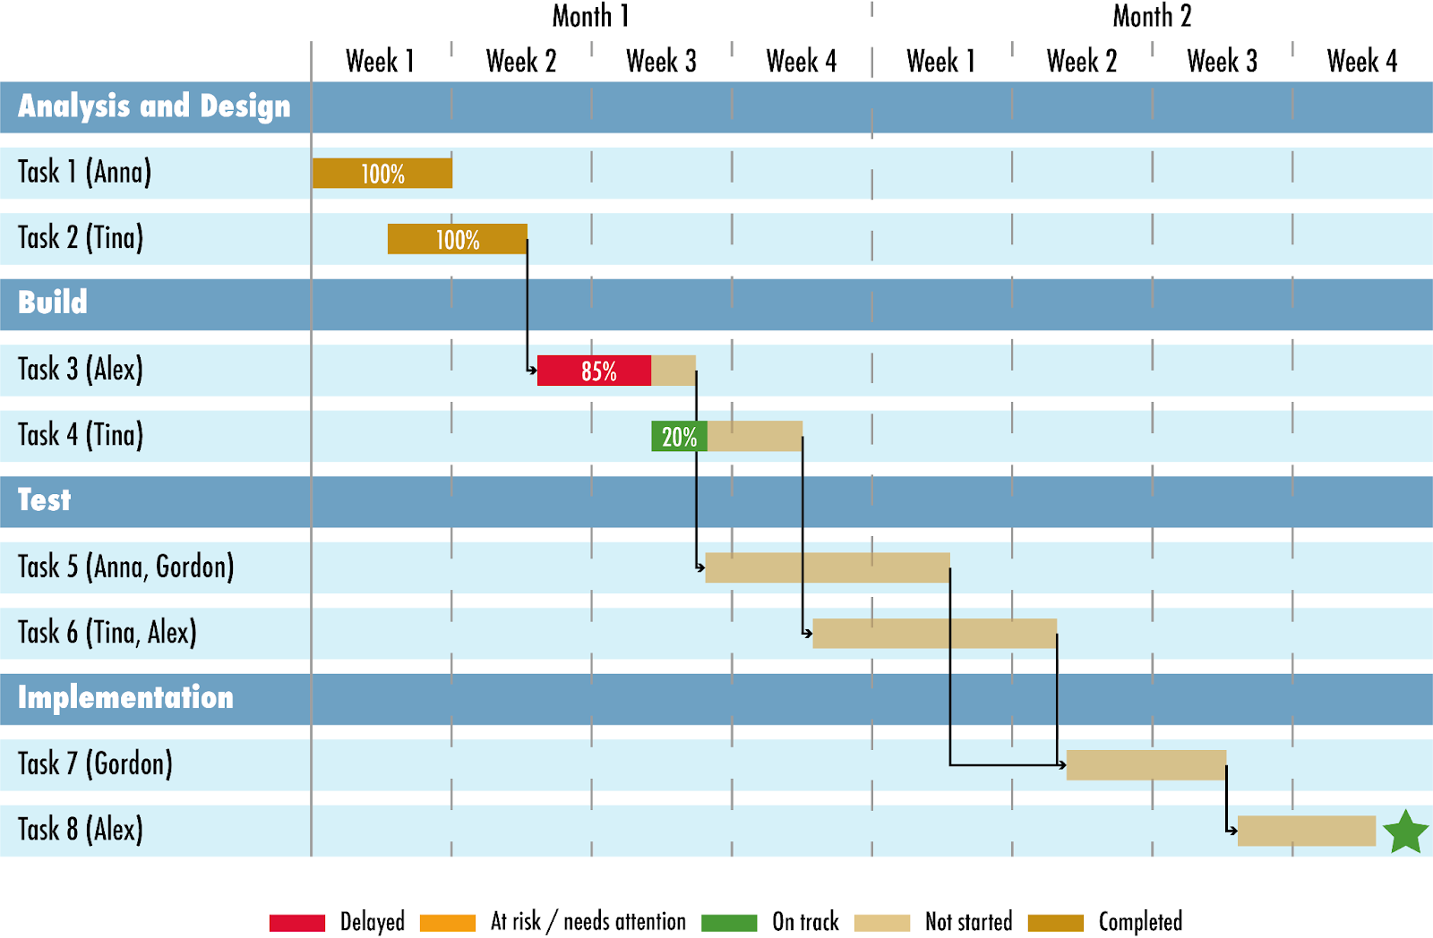
A basic project management Gantt chart

Slide 23
Risk Management
Identify, assess, prioritize, and monitor risks
Use a risk register for documentation
Regularly review and update the risk register

Slide 24
Risk - Impact scales
1 - Negligible
2 - Marginal
3 - Important
4 - Serious
5 - Catastrophic

Slide 25
Risk - Probability scales
1 - Impossible
2 - Remote
3 - Unlikely
4 - Possible
5 - Probable

Slide 26
Risk Categorisation Matrix
Risk register | Probability (1 low to 5 high) | Impact (1 low to 5 high) | Assessment | Management / Mitigation / Contingency
Not being able to gain number 1 position for a secondary keyword “SK1” | 2 | 2 | 2 x 2 = 4 | Use a range of secondary keywords and set expectations, Use of SEMRush position tracker to monitor placement
Being blacklisted by Google or other search engine | 3 | 3 | 3 x 3 = 9 | Keeping to good practice guidelines and monitoring analytics
Negative reception to influencer choice | 4 | 5 | 3 x 5=20 | Select influencers based on natural fit and use organic influencers where possible and amplify with paid support
Hacking | 5 | 5 | 5 x 5 =25 | Use security software, change passwords frequently, contract information security specialists

Slide 27
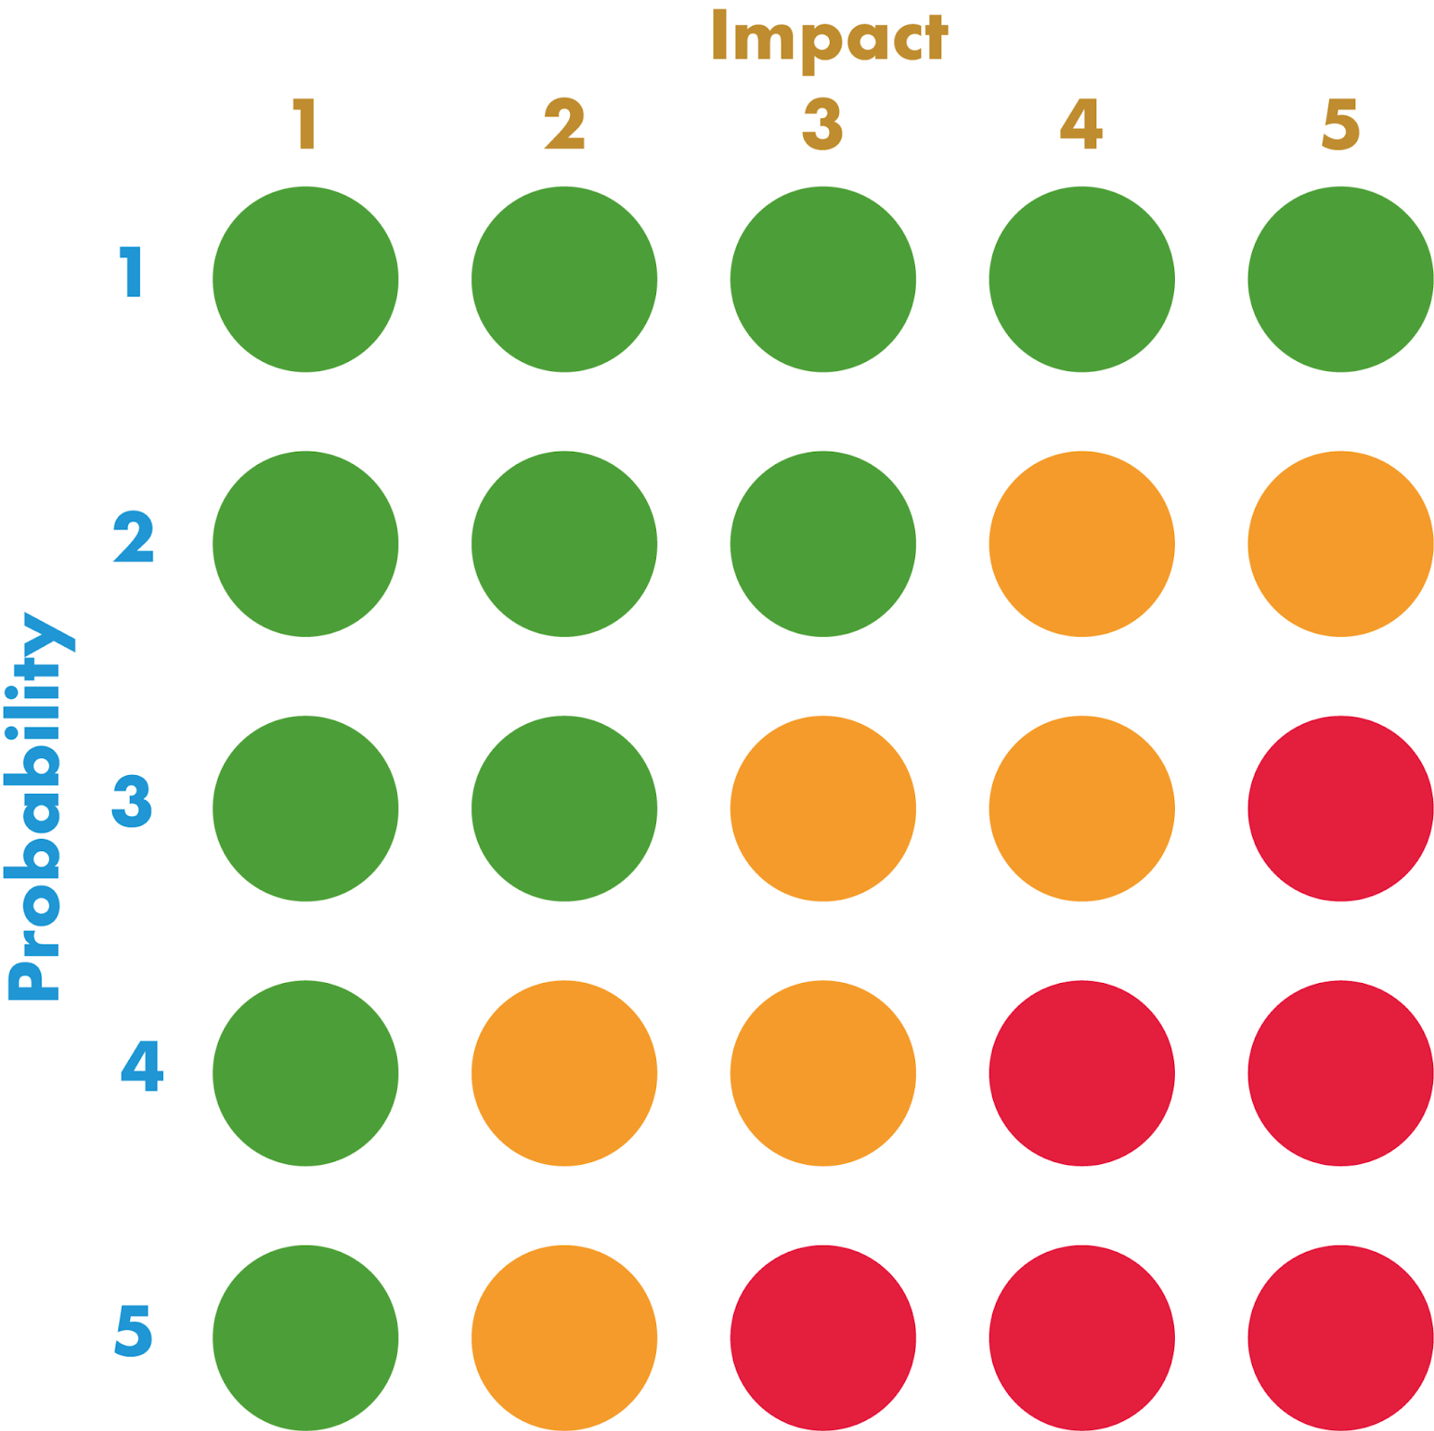
RAG rating assessment of risk

Slide 28
Overall project assessment
1 x risk at Red (assessment of 16 – 25)
1 x risk at Amber (assessment of 7 – 12)
1 x risk at Green (assessment of 0 – 6)
Is the project viable?
Are all risks on Red difficult to mitigate?

Slide 29
Budgeting
Methods: Affordable, Percentage-of-sales, Objective-and-task
Monitor and update budget regularly
Align budget with campaign goals and available resources

Slide 30
Integration Management
Ensures tasks are conducted correctly and on time
Daily and weekly monitoring of schedules, costs, and risks
Adjust plans based on unforeseen circumstances

Slide 31
Communications Management
Formal and informal communication among stakeholders
Use tools like ABCD reports for regular updates
Management-by-exception for critical issues

Slide 32
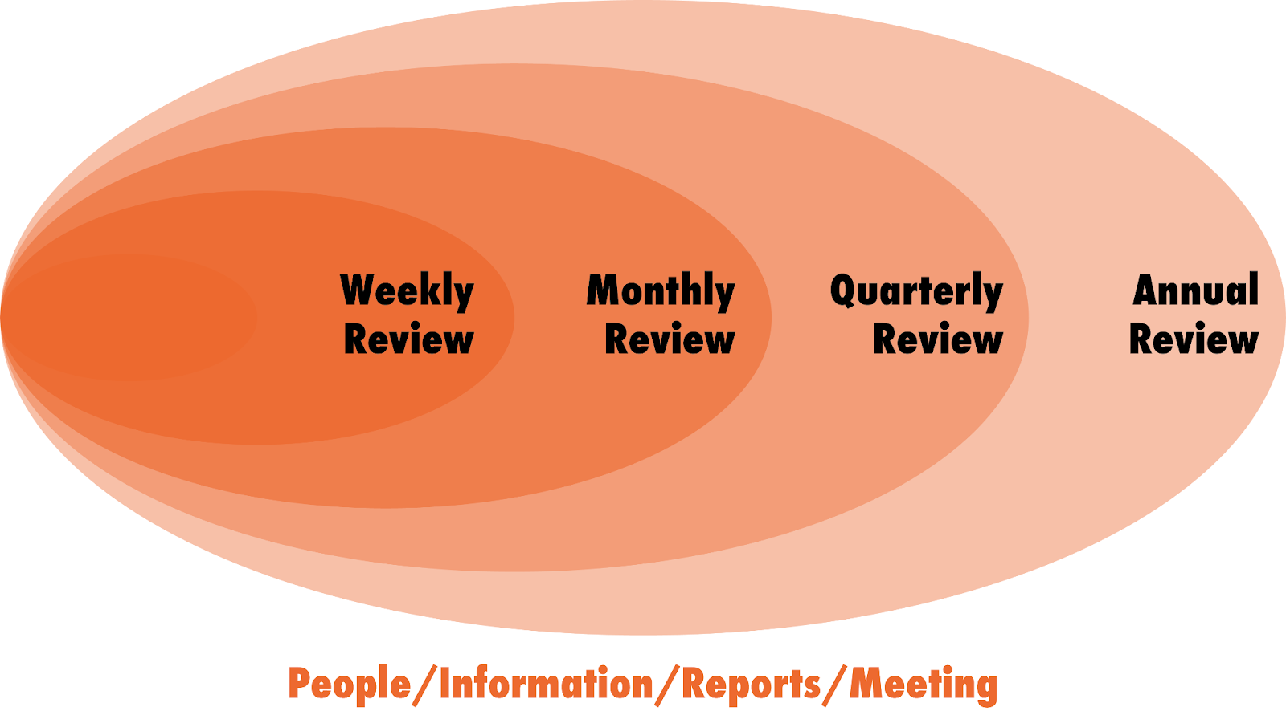
Communications plan

Slide 33
ABCD report structure
 | Definition | Topic covered | Purpose
A | Achievements | Highlight achievements in the covered period. Be specific. Not, “working on stuff, ongoing work”. Focus on what has been achieved. | Report on what was achieved, not a list of what was done. Data driven.
B | Benefits | Benefit of the achievement. Each achievement should have at least one matching benefit. Be critical, transparent and honest. | Data driven and linked to objectives.
C | Concerns | List concerns related to the project/campaign as it can help to address issues early on. Evidence issues/problems with relevant data | The project manager (who is accountable) needs to effectively tackle issues before they arise. All concerns must be addressed in the Do Next section.
D | Do Next | Key aspects of the priorities in the work plan (weekly, monthly, fortnight-reporting frequency to be agreed with beforehand) Recommend actions to address concerns. | Improve visibility and transparency of future tasks. Identify whether the work load is realistic.

Slide 34
ABCD report example
Project: Mothers’ Day 2025 Report’s date: 20th December 2024 Author: AH
Achievements | Benefits
Agency briefed and paid for advertising and influencers recruited and space bought. Keywords research completed and integrated to mock ups ready for sign off. Campaigns set up in relevant channels and ready for launch date. | Agency clear on deadlines and break down of costs provided. Aligned with the forecasted budget. On track to achieve Year 1 - £60K sales.
Concerns | Do next
Marketing lead going on maternity leave next month may jeopardise continuity of strategy and campaign delivery. A member of the packing team is off sick, required to cover extra demand generated by the campaign. | Carry out Mothers’ Day campaign. Monitor and optimise as required. Immediately recruit maternity leave cover and put together a hand over and plan to ensure campaigns’ continuity. Revise working rota and recruit temporary staff for packing if required according to forecasted orders.

Slide 35
Internal Stakeholder Engagement
Use RACI matrix to clarify roles
01
Maintain open communication to avoid conflicts
02
Engage stakeholders appropriately based on their roles
03

Slide 36
Resource Management
Deploy the right people at the right time
Manage resources within a matrix management environment
Account for temporary contract workers if needed

Slide 37
Quality Management
- Ensures project outcomes meet documented requirements
- Quality assurance and control from the outset
- Measure success through defined metrics

Slide 38
Monitoring Phase
Track current activity and progress against original plans
1
Use live tracking Gantt charts
2
Document mistakes and successes for future improvement
3

Slide 39
Summary
Every campaign is a project
Use project management tools and techniques for better control
Document lessons learned for continuous improvement

